Slide 1
Managed Availability Made Easy
Jay Cotton
Microsoft Premier Field Engineer
Notes:
This is a good time to mention that we have other sessions supporting O365.
Introduction to O365
Preparing for Migration
In place eDiscovery / Hold & MRM

Slide 2
Managed Availability
Managed Availability works by implementing Probes, Monitors and Responders:
The Probe is the component that performs the simple test. It doesn’t care whether the test passes or fails. It simply performs the test.
The Monitor consumes the results of the Probe, and uses that to determine the Health state of the item being monitored.
Depending on the Health state, one or more graduated Responder actions may be invoked. All of this information is logged in the Crimson event channel under Active Monitoring, or Managed Availability.

Slide 3
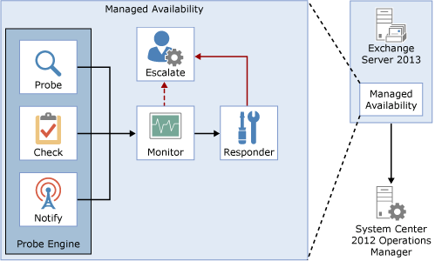
Managed Availability (Quick Review)

Slide 4
Probes
Measure the user’s perception of the service
Typically synthetic user transactions (e.g., send a message via OWA)

Slide 5
Monitors
Evaluates data collected by probes to determine if action needs to be taken
  Depending on the rule, a monitor can initiate a responder or escalate
Defines the time from failure that a responder is executed

Slide 6
Responders
Executes a response to alert generated by a monitor
Responders
  Restart – Terminates and restarts service
  Reset AppPool – Cycles IIS application pool
  Failover – Initiates a database or server failover
  Bugcheck – Initiates a bugcheck of the server
  Offline – Takes a protocol on a machine out of service
  Online – Places a machine back into service
  Escalate – Escalates an issue to an admin

Slide 7
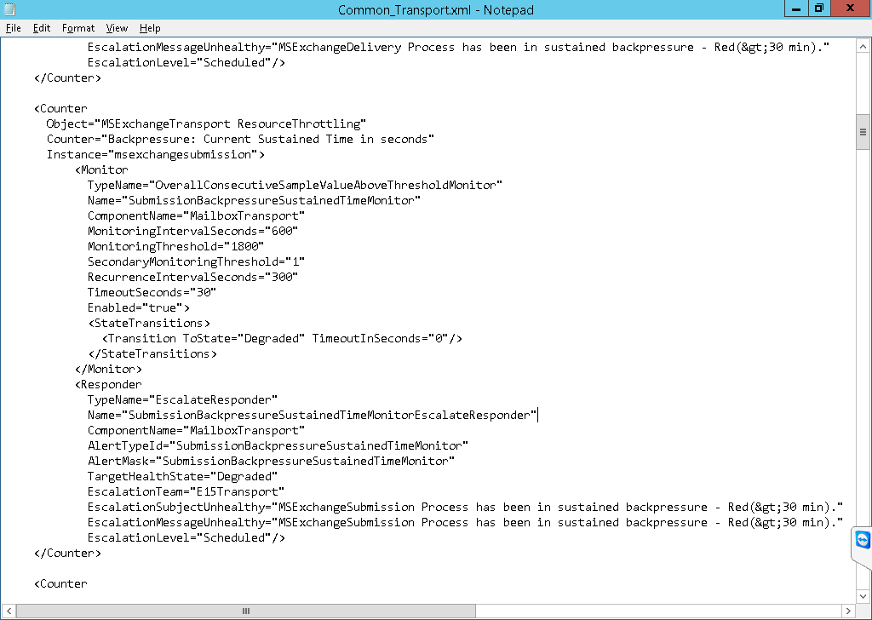
Settings
XML files in the $exinstall\bin\Monitoring\config folder are used to store configuration settings for some of the probe and monitor work items.

Slide 8
Management Tasks and Cmdlets
Extract or view system health
  Get-ServerHealth
  Get-HealthReport
View probes, monitors and responders for a health set
  Get-MonitoringItemIdentity
Details about probes, monitors, and responders
  Get-MonitoringItemHelp

Slide 9
Overrides
Admins can alter the thresholds and parameters used by the probes, monitors and responders
  Enables emergency actions
  Enables fine tuning of thresholds specific to the environment
Can be deployed for specific servers or for the entire environment
  Server related overrides are stored in the registry
  Global overrides are stored in Active Directory

Slide 10
Overrides
Can be set for a specified duration or to apply to a specific version of the server
Are not immediately implemented
  Exchange Health Service reads configuration every 10 minutes
  Global changes depend on Active Directory replication
Wildcards are not supported
  Cannot override entire health set in one task

Slide 11
Management Tasks and Cmdlets
Create an override
  Add-ServerMonitoringOverride
  Add-GlobalMonitoringOverride
View overrides
  Get-ServerMonitoringOverride
  Get-GlobalMonitoringOverride
Remove an override
  Remove-ServerMonitoringOverride
  Remove-GlobalMonitoringOverride

Slide 12
Event Logging
Managed Availability makes extensive use of crimson channel event log
  Microsoft-Exchange-ActiveMonitoring
    ProbeDefinition
    ProbeResult
    MonitorDefinition
    MonitorResult
    ResponderDefinition
    ResponderResult
  Microsoft-Exchange-ManagedAvailability
    Monitoring
    RecoveryActionResults

Slide 13
Definitions
Probe, monitor and responder definitions initialized and logged when Health Manager worker process starts

Slide 14
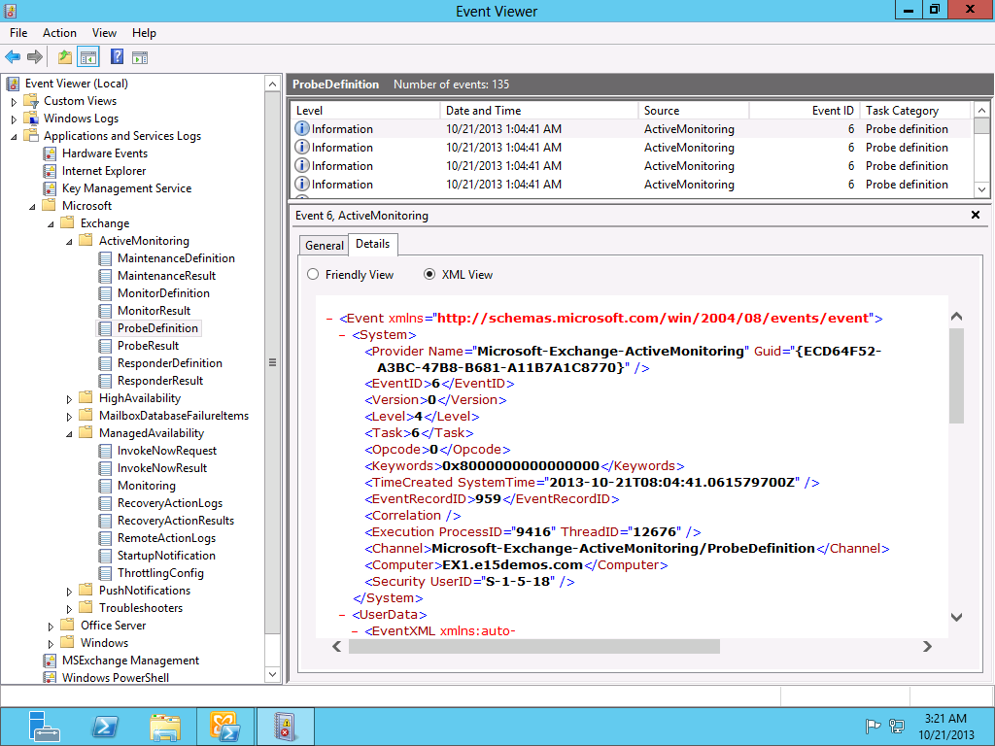
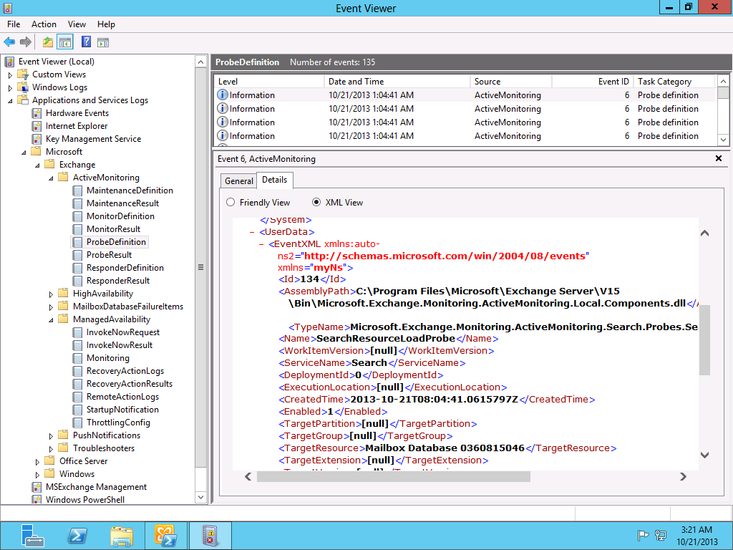
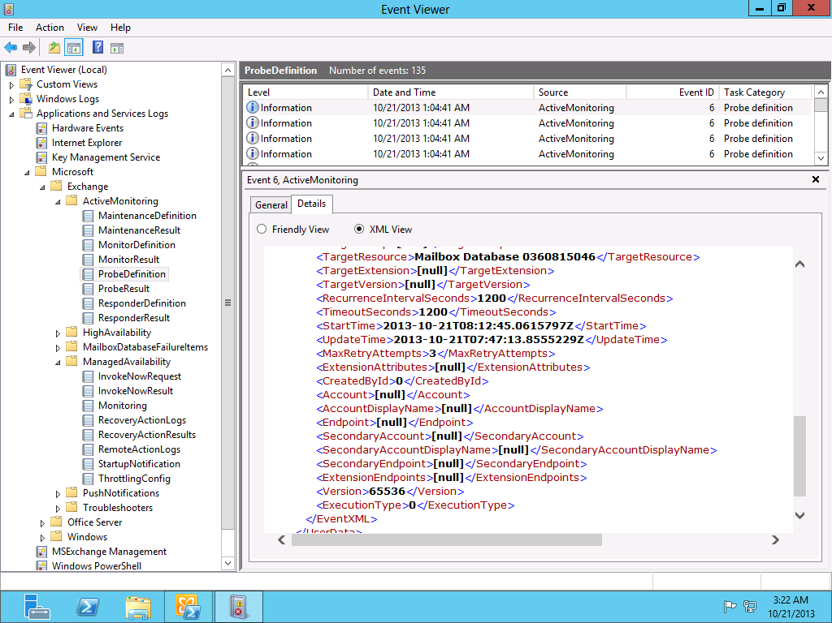

Slide 15
Managed Availability – Recovery Actions
Managed availability logs all recovery actions to the crimson channel
  Microsoft.Exchange.ManagedAvailability/RecoveryActions
  Event 500 indicates that a recovery action was started
  Event 501 indicates that a recovery action was successful
  Event 502 indicates that a recovery action was unsuccessful

Slide 16
Managed Availability – Recovery Actions
Useful properties for Recovery Action event
  Id - Action that was taken. Common values are RestartService, RecycleApplicationPool, ComponentOffline, or ServerFailover
  State - Whether the action has started (event 500) or finished (event 501/502)
  ResourceName - The object that was affected by the action. This will be the name of a service for RestartService actions, or the name of a server for server-level actions
  EndTime - The time the action completed
  Result - Whether the action succeeded or not
  RequestorName - The name of the Responder that took the action

Slide 17
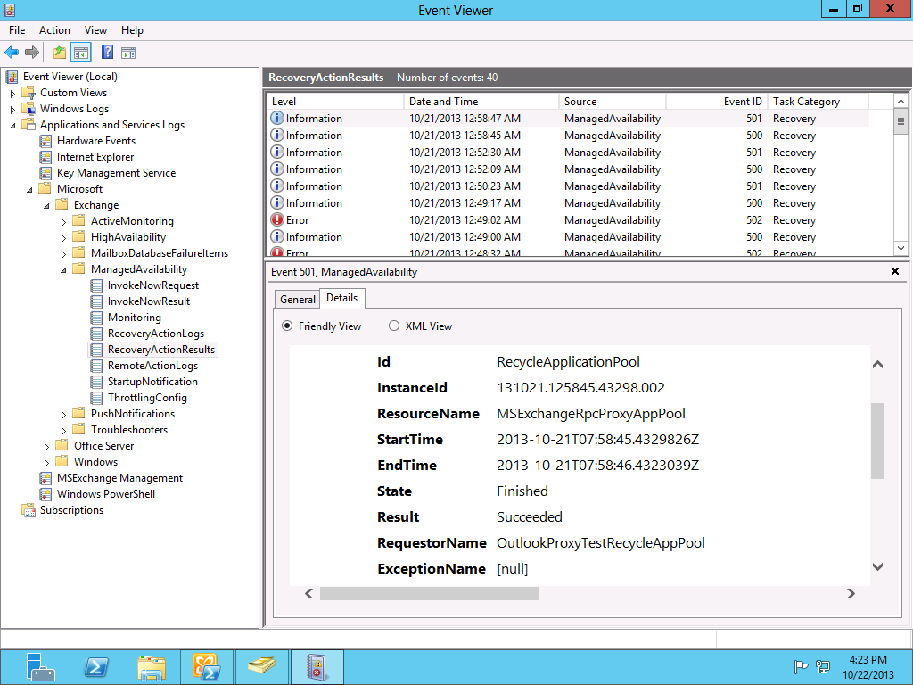
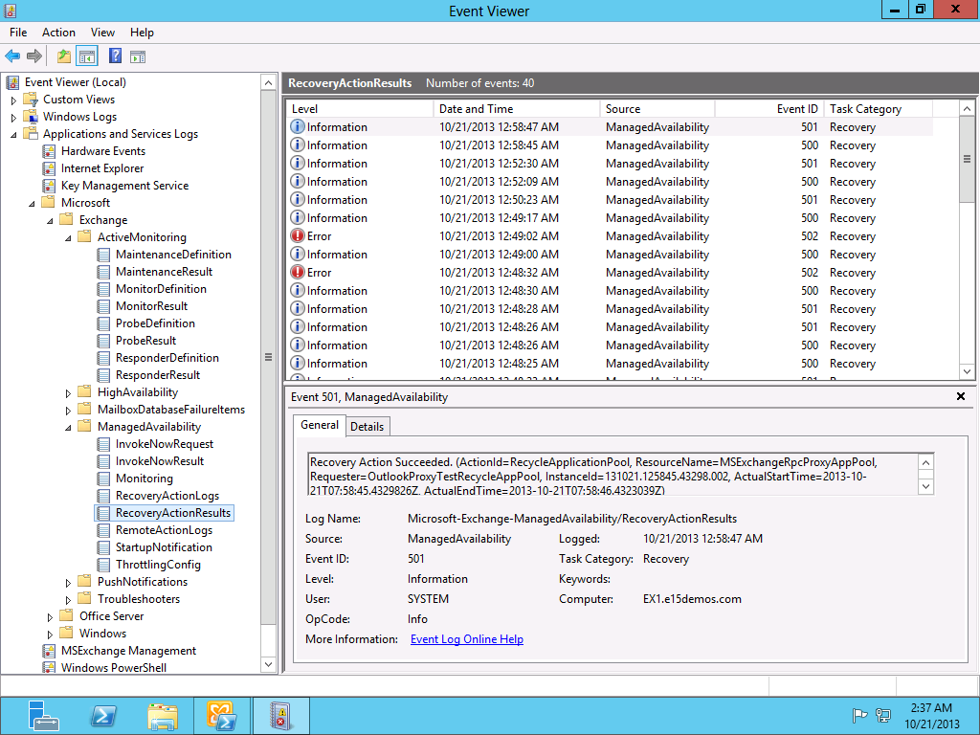

Slide 18
How to Troubleshoot

Slide 19
1. Get-HealthReport (as a current review)
2. Start with MA Recovery Actions
3. Then look at responders
4. Review the monitors for those responders
5. Then dig into the probes for those monitors.
Troubleshooting Managed Availability

Slide 20

© 2012 Microsoft Corporation. All rights reserved. Microsoft, Windows, Windows Vista and other product names are or may be registered trademarks and/or trademarks in the U.S. and/or other countries.
The information herein is for informational purposes only and represents the current view of Microsoft Corporation as of the date of this presentation. Because Microsoft must respond to changing market conditions, it should not be interpreted to be a commitment on the part of Microsoft, and Microsoft cannot guarantee the accuracy of any information provided after the date of this presentation. MICROSOFT MAKES NO WARRANTIES, EXPRESS, IMPLIED OR STATUTORY, AS TO THE INFORMATION IN THIS PRESENTATION.

