Slide 1
Exchange 2010
Mailbox Server Role Requirements Calculator

Slide 2
Conditions and Terms of Use
This training package is proprietary and confidential, and is intended only for uses described in the training materials. Content and software is provided to you under a Non-Disclosure Agreement and cannot be distributed. Copying or disclosing all or any portion of the content and/or software included in such packages is strictly prohibited.
The contents of this package are for informational and training purposes only and are provided "as is" without warranty of any kind, whether express or implied, including but not limited to the implied warranties of merchantability, fitness for a particular purpose, and non-infringement.
Training package content, including URLs and other Internet Web site references, is subject to change without notice. Because Microsoft must respond to changing market conditions, the content should not be interpreted to be a commitment on the part of Microsoft, and Microsoft cannot guarantee the accuracy of any information presented after the date of publication. Unless otherwise noted, the companies, organizations, products, domain names, e-mail addresses, logos, people, places, and events depicted herein are fictitious, and no association with any real company, organization, product, domain name, e-mail address, logo, person, place, or event is intended or should be inferred.
Copyright and Trademarks
© 2012 Microsoft Corporation. All rights reserved.
Microsoft may have patents, patent applications, trademarks, copyrights, or other intellectual property rights covering subject matter in this document. Except as expressly provided in written license agreement from Microsoft, the furnishing of this document does not give you any license to these patents, trademarks, copyrights, or other intellectual property.
Complying with all applicable copyright laws is the responsibility of the user. Without limiting the rights under copyright, no part of this document may be reproduced, stored in or introduced into a retrieval system, or transmitted in any form or by any means (electronic, mechanical, photocopying, recording, or otherwise), or for any purpose, without the express written permission of Microsoft Corporation.
For more information, see Use of Microsoft Copyrighted Content at
http://www.microsoft.com/about/legal/permissions/
Microsoft®, Internet Explorer®, and Windows® are either registered trademarks or trademarks of Microsoft Corporation in the United States and/or other countries. Other Microsoft products mentioned herein may be either registered trademarks or trademarks of Microsoft Corporation in the United States and/or other countries. All other trademarks are property of their respective owners.

Slide 3
Introduction
Kamal Abburi
Premier Field Engineer
www.mrproactive.com

Slide 4
Premier Field Engineering - What do we do
Proactive Services
  Workshops
  Health Checks
  Risk Assessments
  Supportability Reviews
  Chalk & Talks
  Knowledge Transfers
Reactive Support
Troubleshooting & RCA
Partner with PG
Technical Leadership
Global Community
Onsite and Remote

Slide 5
Overview
Understand the planning involved for Exchange 2010
Understand Exchange 2010 environment design & sizing
Understand Mailbox Server Role Requirements Calculator - the input factors and interpret the Output results

Slide 6
Objective
How to use “Exchange 2010 Mailbox Server Role Requirements Calculator “
Determine the appropriate requirements and sizing

Slide 7
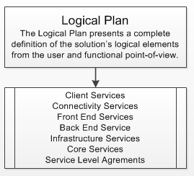
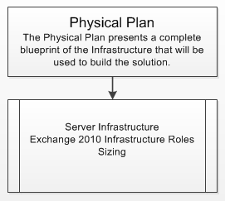
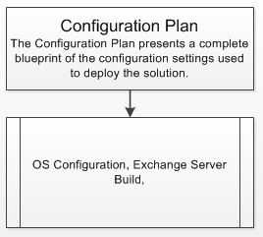
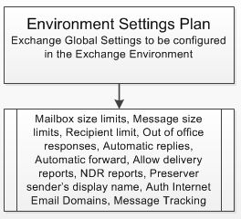
Planning

Slide 8
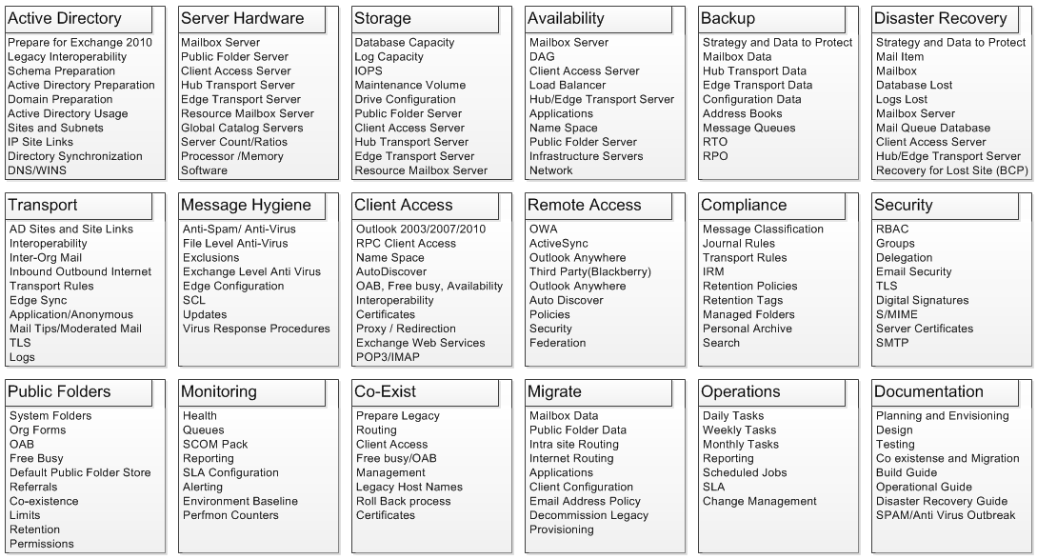

Components

Slide 9
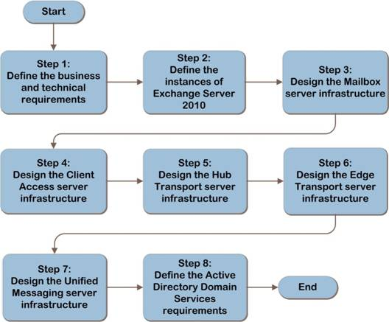
Resources
Infrastructure Planning and Design (IPD) Guide for Microsoft Exchange Server 2010 with Service Pack 1

Slide 10
Exchange 2010 Mailbox Server Role Design
Mailbox Capacity Requirements
Database Copy Requirements
Mailbox I/O Requirements
Mailbox CPU Requirements
Mailbox Memory Requirements

Slide 11
Design – Requirements
Mailbox Count
Mailbox Concurrency
Mailbox Size
Message Profile
  Average message size
  Send / Receive Per Day
Clients
Client Extensions
Server Applications
High Availability
Performance Capacity Reliability

Slide 12
Design – Capacity
Database
  Mailbox Quota
  Recoverable Item Size (Single Item Recovery, Calendar Version)
  White Space
  Mailbox Size = Mailbox Limit + Whitespace + Dumpster
  Database Size = Number of Mailboxes x Mailbox Size on Disk x Database Overhead Growth Factor
  Content Index
Logs
  Transaction logs per day (Message Profile)
  Move mailbox
  Truncation failure tolerance
  Growth
Free Space
High Availability
Backups and Restore

Slide 13
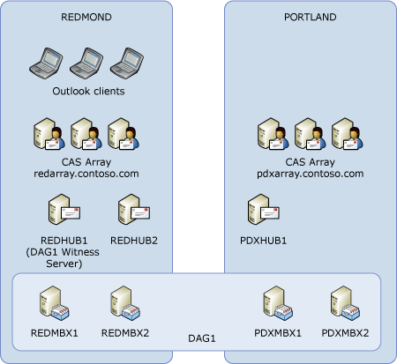
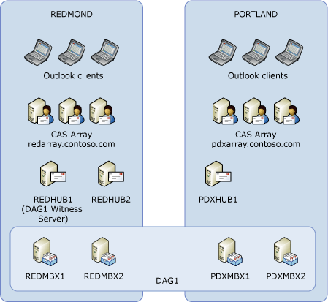
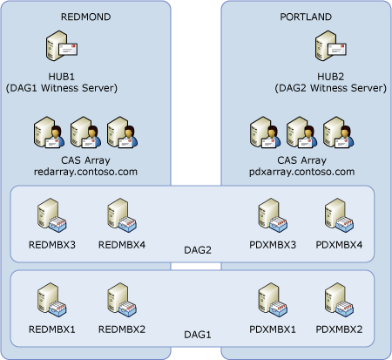
Design – Database Copies
Number of Database Copies
Database Copy Types
  Highly available database copies
  Lagged database copies
Site Resilience
  Active/Passive
  Active/Active
Mailbox Server Resilience
  Design for All Database Copies Activated
  Design for Targeted Failure Scenarios
Multiple Role vs. Stand-Alone Role Servers
Database Copy Layout
Backup Model
Storage Model

Slide 14
Design – I/O
Critical - I/O latency
Transactional I/O
  Database I/O
  Log Volume /IO
Sequential I/O
  BDM
  MRM
  Online Maintenance - Defrag

Slide 15
Design – I/O Factors
Database Files and Log Files Share a Single Volume
Dedicated Database File Volume
Content Indexing
Message Profile
DB Cache Size
I/O read/write ratios
Desktop Search Engines
Outlook Online Mode Clients
Items per folder

Slide 16
Design - CPU
Active and passive database copies on the same server
  Design for all database copies activated
  Design for targeted failure scenarios
Database copy count
  10 percent increase for each additional database copy

Slide 17
CPU - Server Roles
Mailbox:Hub Transport
  7:1 (no antivirus scanning on Hub Transport server)
  5:1 (with antivirus scanning on Hub Transport server)
Mailbox:Client Access
  4:3
Mailbox:Client Access and Hub Transport combined role
  1:1
AD Servers
  32-bit 1:4
  64-bit 1:8

Slide 18
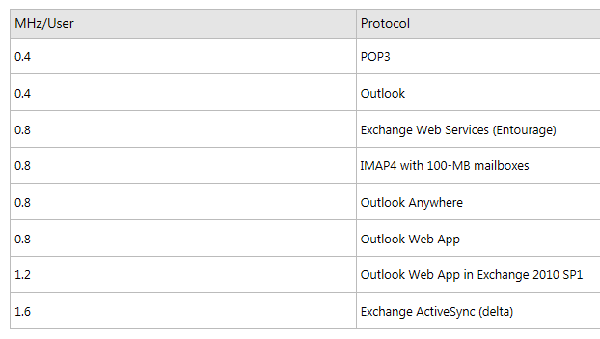
Costs per user for Exchange protocols
Sample based on 80 messages received and 20 messages sent in an average day
Windows Server 2008 R2 is a much better choice

Slide 19
Design - Memory
Mailbox Database Cache
Database Count
User Profile

Slide 20
Memory – Server Roles

Slide 21
Validation Tools
Jetstress
  Simulates Exchange I/O
  Verify disk performance
  Review Jetstress Field guide
Loadgen
  Benchmarking,
  Pre-deployment validation,
  Stress testing tool
  Simulate the delivery of multiple MAPI client messaging requests to an Exchange server

Slide 22
Mailbox Server Role Requirements Calculator
Demo

Slide 23
Best Practices
Don’t Share Physical Spindles
Use Redundant Paths (iSCSI or Fiber)
HBA Tuning inline with Storage Vendors (Queue Depth)
Stripe Size or Block Size
Storage Array Cache Settings
Mount Points
NTFS Allocation Unit (64K)
No NTFS Compression or EFS
Test and Validate with JetStress

Slide 24
Considerations
Keep it simple
Multi Role Servers
Exchange 2010 Tested Solutions
  Showcases well designed and cost effective solutions
  Common customer scenarios
Exchange 2010 Solution Reviewed Program (ESRP) – Storage v3.0
  Uses the ESRP framework to test the storage solutions
  Help plan/design their own Exchange storage architectures
  The ESRP – Storage program is not a Microsoft certification
Best Practices for Virtualizing Exchange Server 2010 with Windows Server® 2008 R2 Hyper V™ Guide
VMware Best Practices Guide for Exchange 2010
Understand Virtualization Support Scenarios

Slide 25
Take Away
Gather Storage Input Requirements
Design Storage Architecture Based on I/O and Capacity Requirements
  Mailbox Server Role Requirements Calculator
Validate Storage for Performance and Reliability
Monitor Server Storage Health
Monitor Storage Solution Health

Slide 26
Premier Field Engineering - How can we help
Exchange Server 2010 Migration Readiness Assessment
Microsoft Risk and Health Assessment Program for Exchange Server
Workshop - Exchange Server 2010: Transitioning from Exchange 200x
Chalk Talk - Exchange Server 2010: Upgrading from Exchange 200x
Chalk Talk - Exchange Server 2010: Using Exchange Pre-Deployment Tools
WorkshopPLUS - Exchange Server 2010: Administration and Troubleshooting

Slide 27
Questions
Kamal.Abburi@microsoft.com

