Slide 1
Office 365 Review from the End Users and IT Admin Perspective
Presented by:
Adam Satcowitz
Tristate IT, LLC www.tristateit.net
Presented April 10, 2012 at NYExUG Meeting
Last Updated on April 9, 2012

Slide 2
About Adam Satcowitz
Office 365 experience as an IT consultant to understand end user and administrator perspectives.
Experience with Exchange 2003, 2007, and 2010.

Slide 3
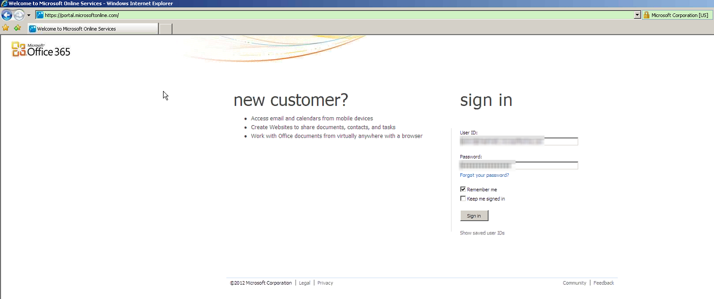

Slide 4
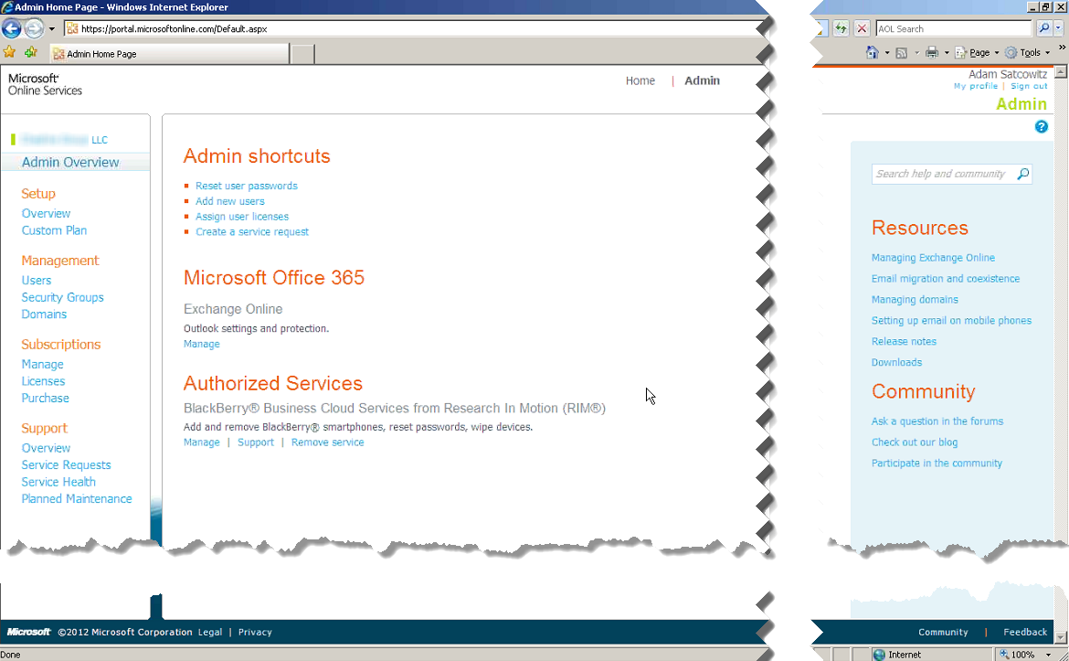

Slide 5
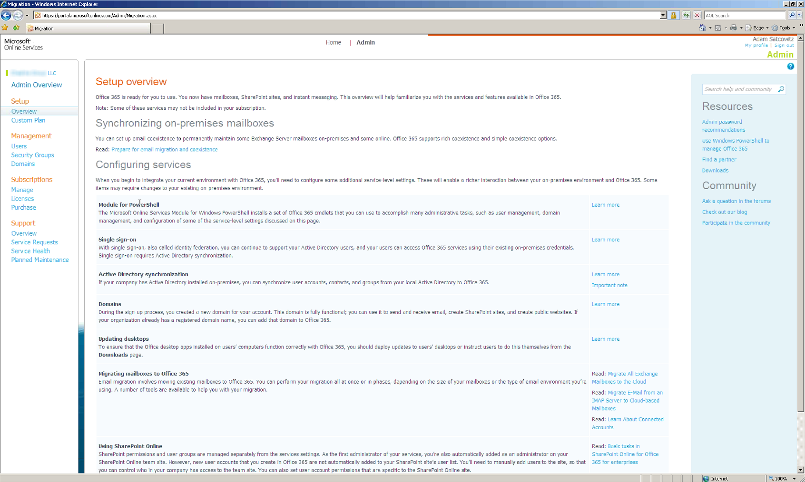

Slide 6
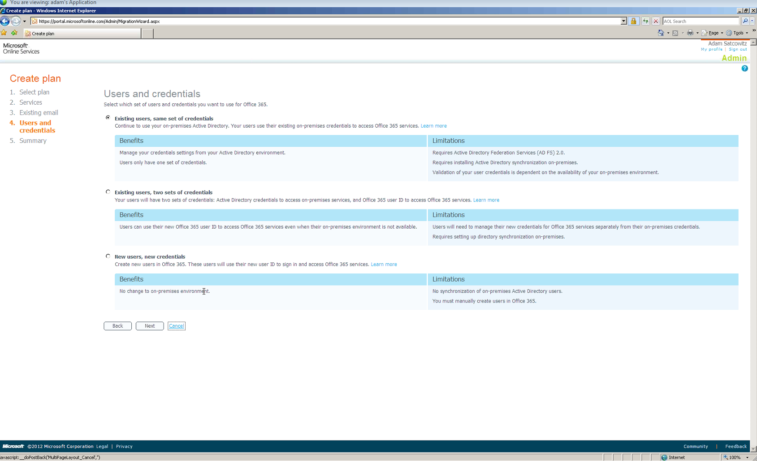

Slide 7
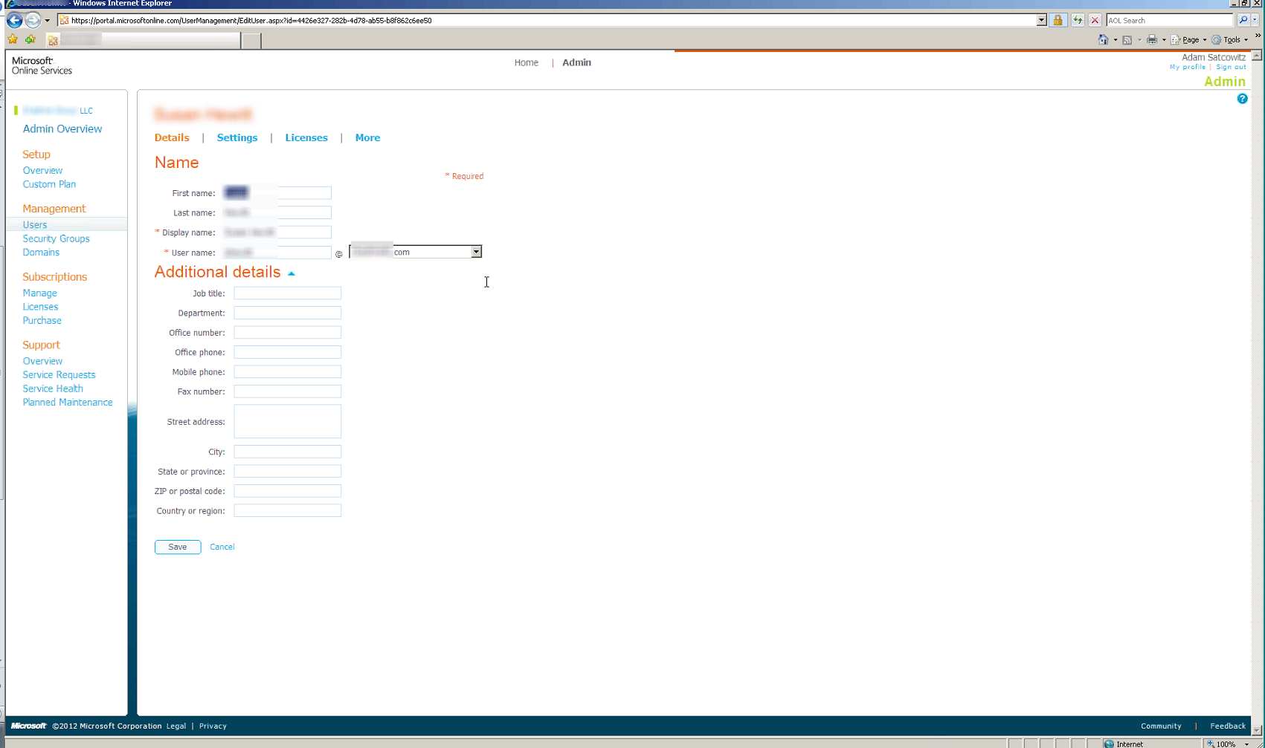

Slide 8
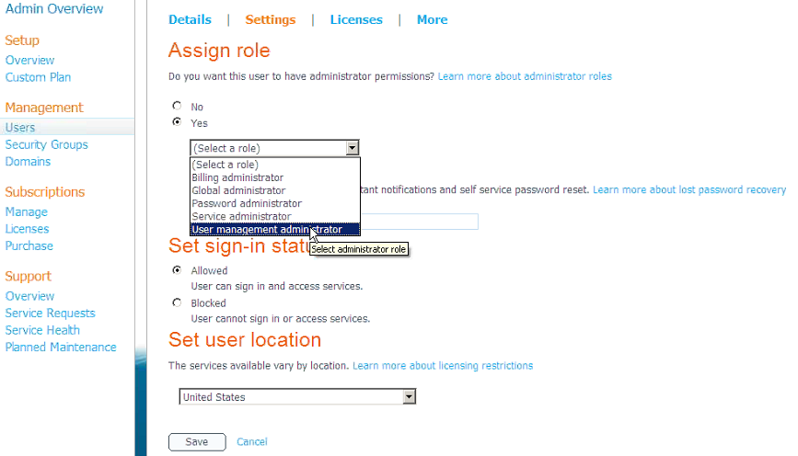

Slide 9
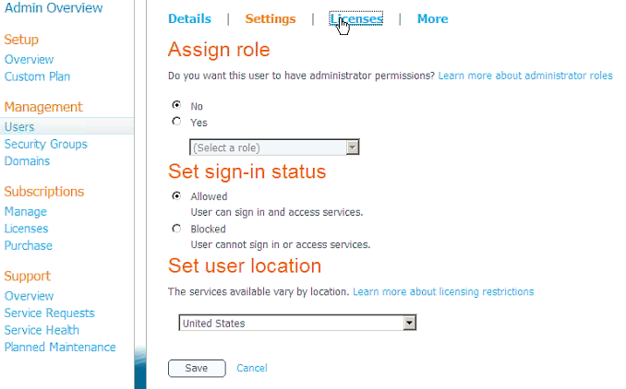

Slide 10
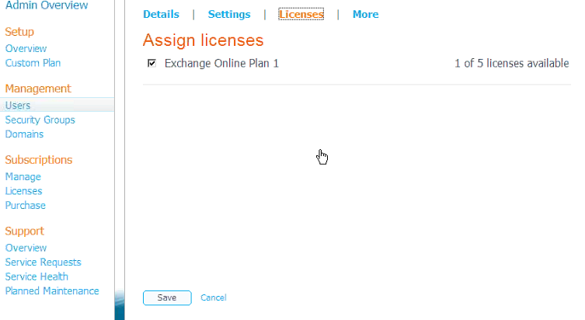

Slide 11
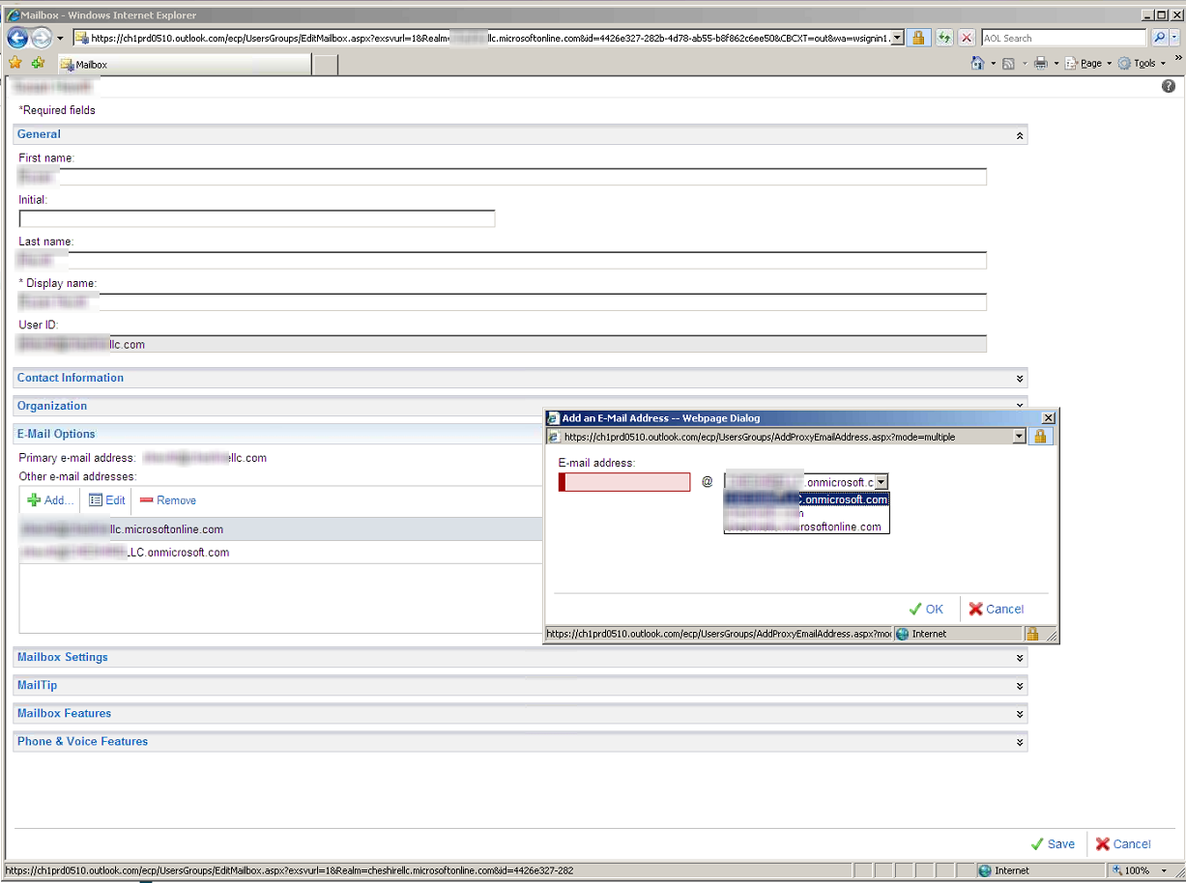

Slide 12
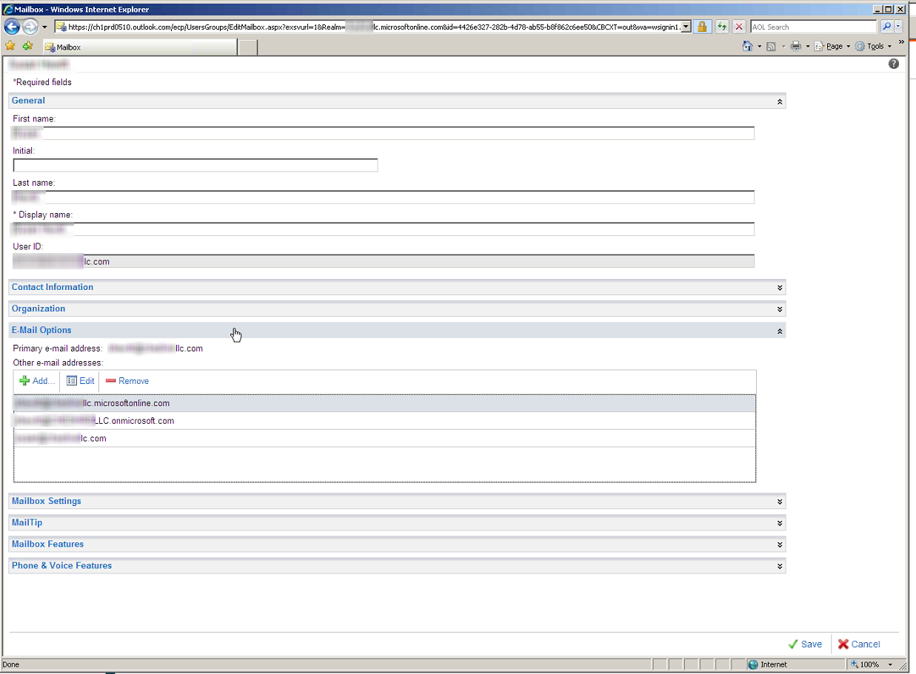

Slide 13
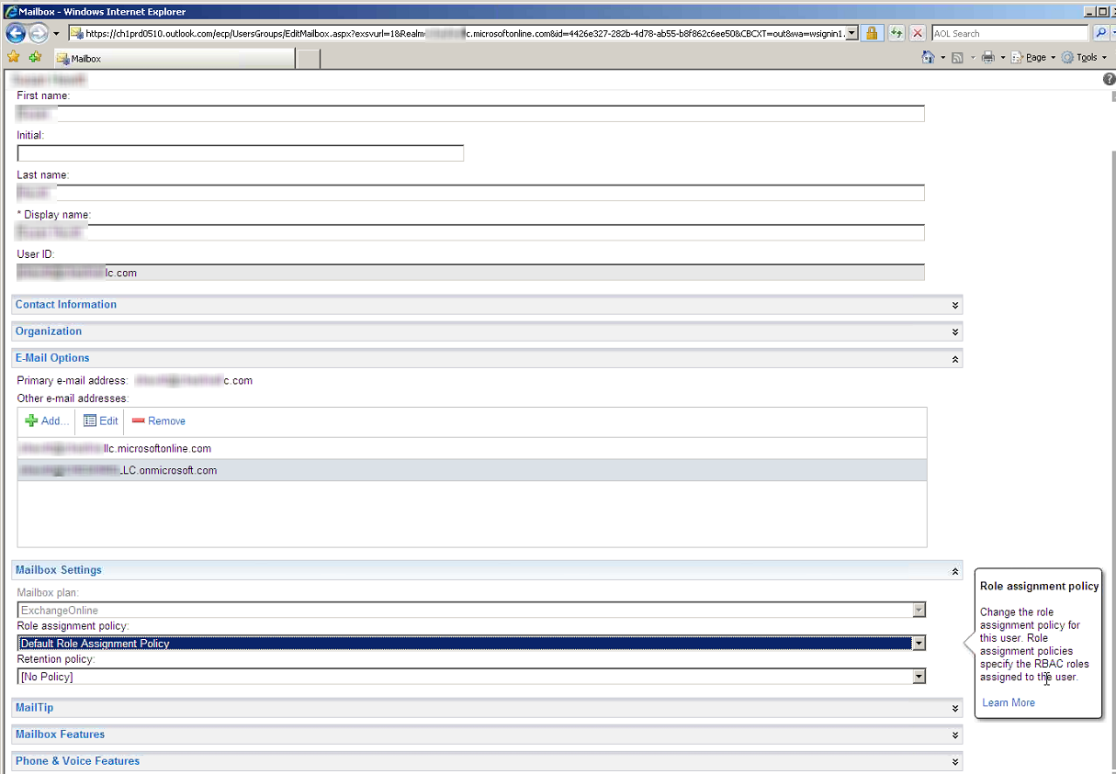

Slide 14
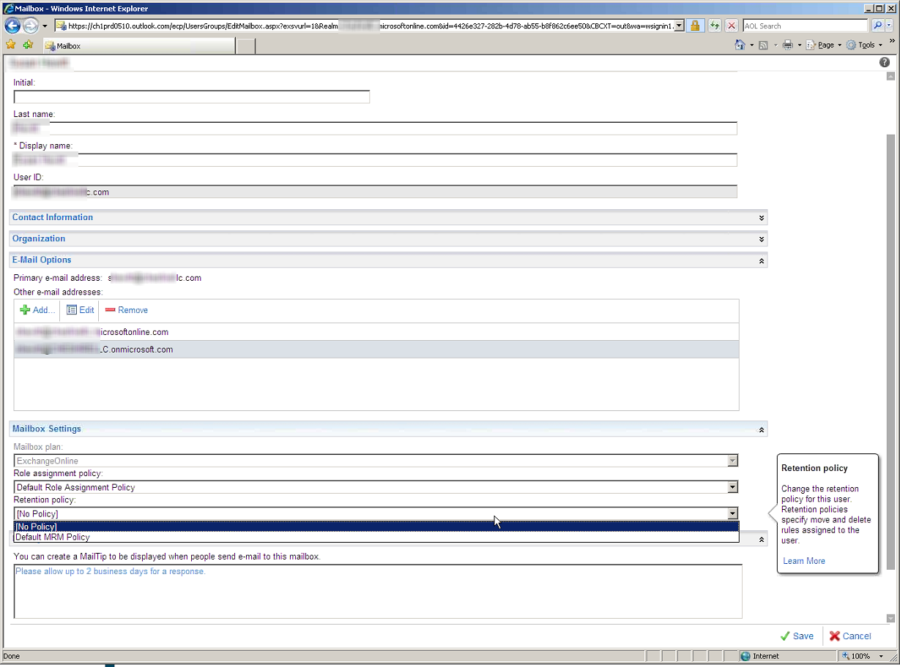

Slide 15
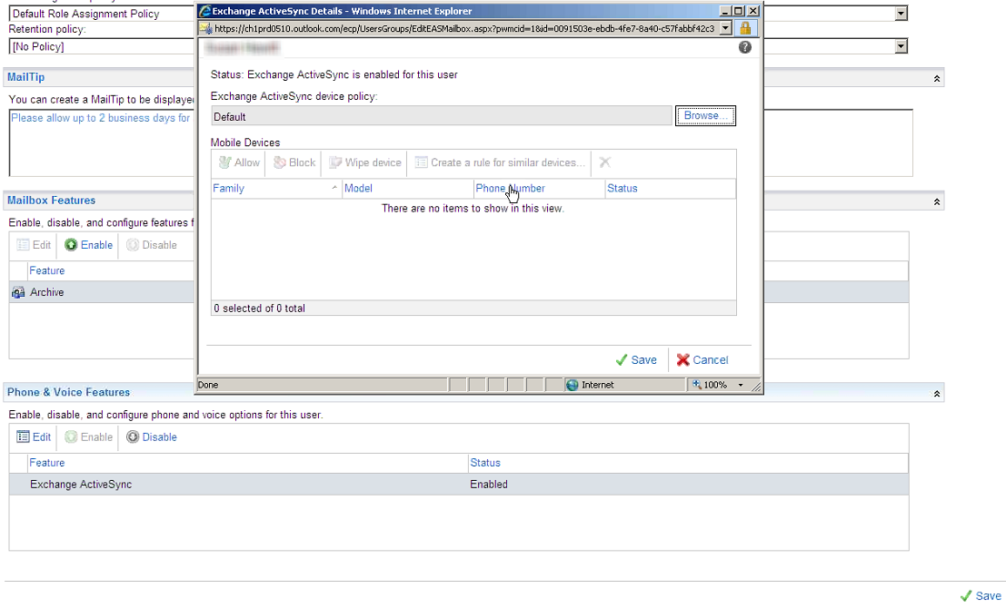

Slide 16
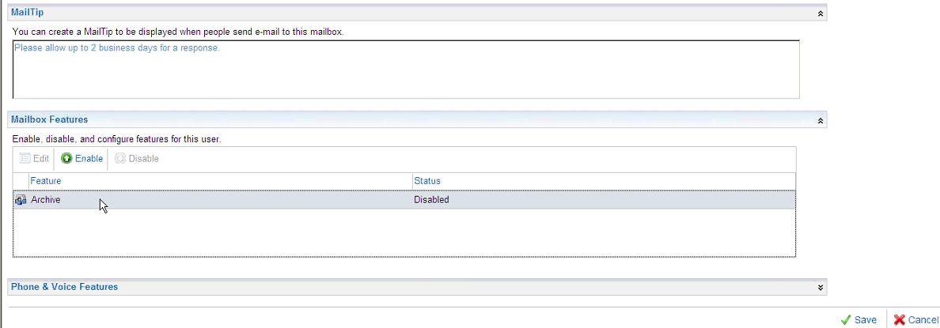

Slide 17
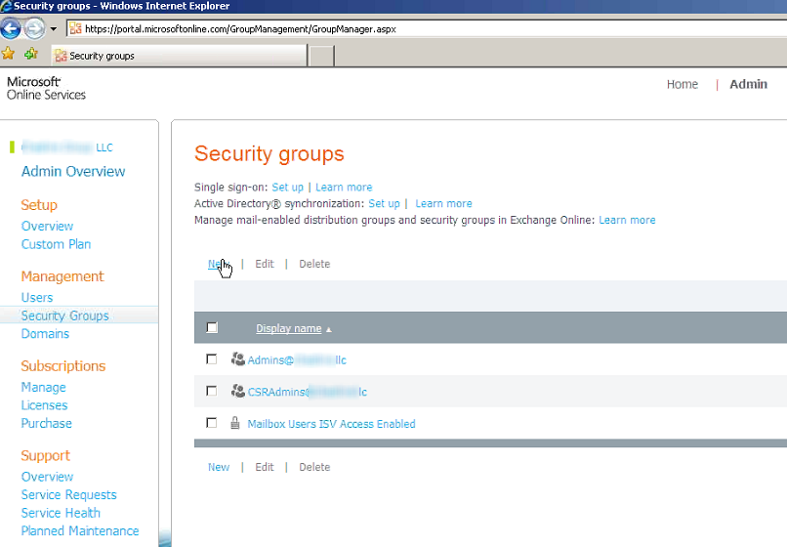

Slide 18
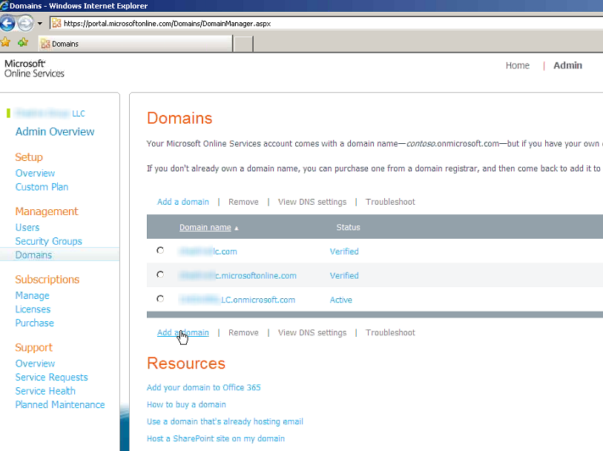

Slide 19
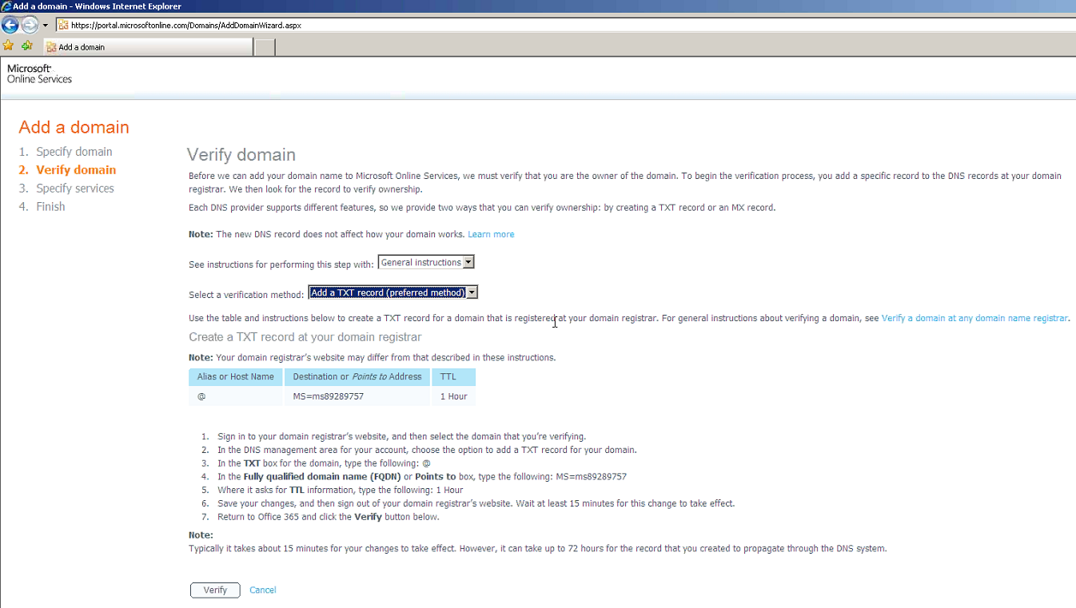

Slide 20
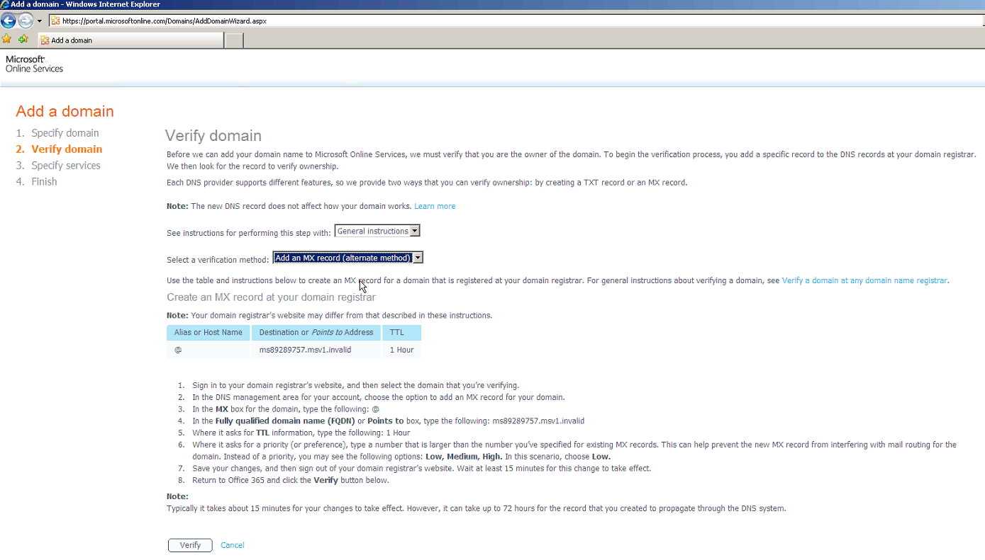

Slide 21
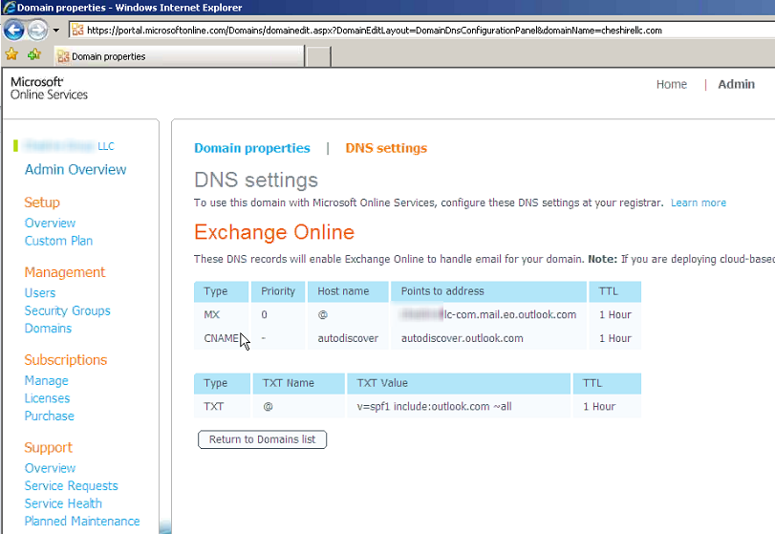

Slide 22
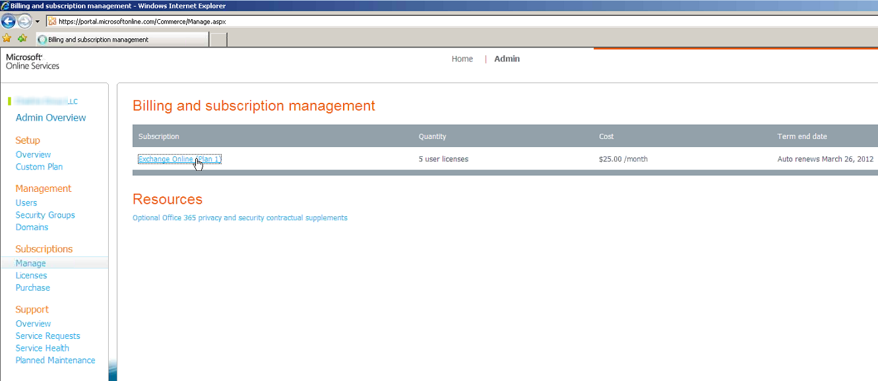

Slide 23
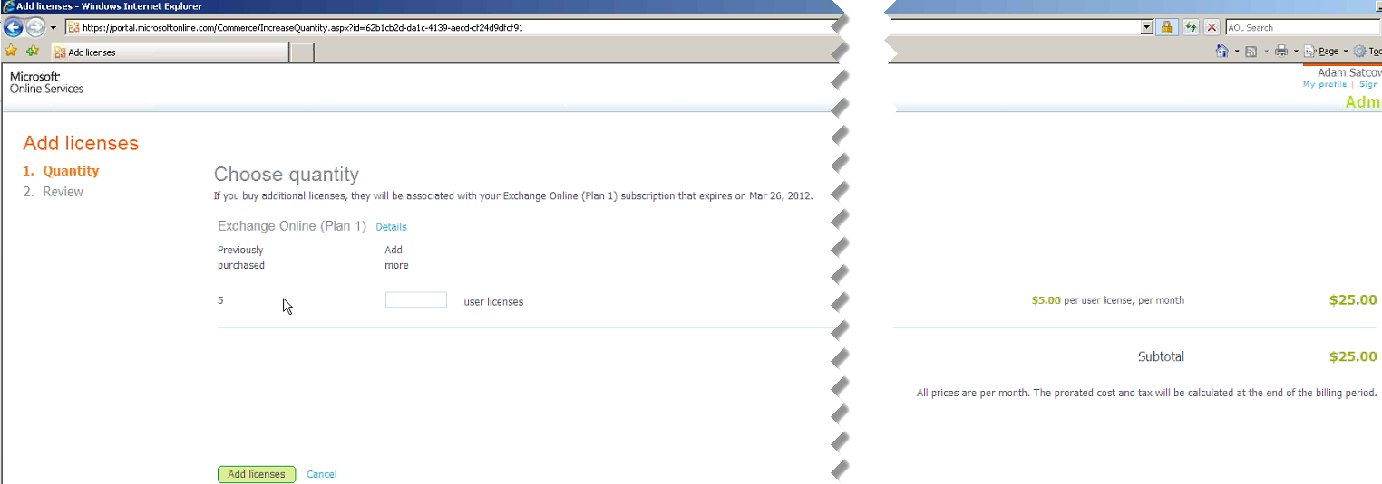

Slide 24
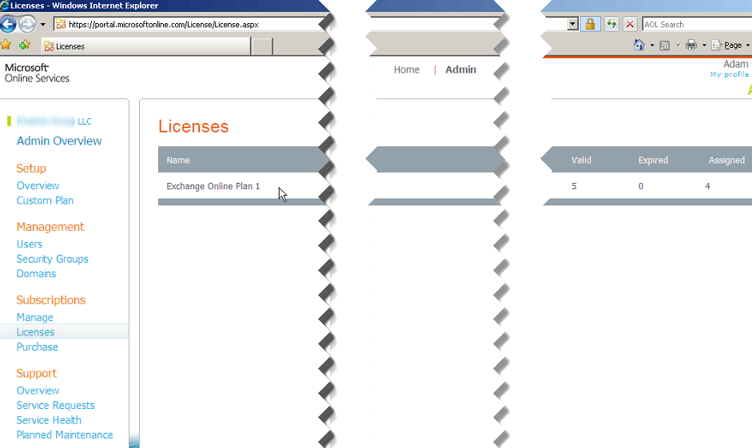

Slide 25
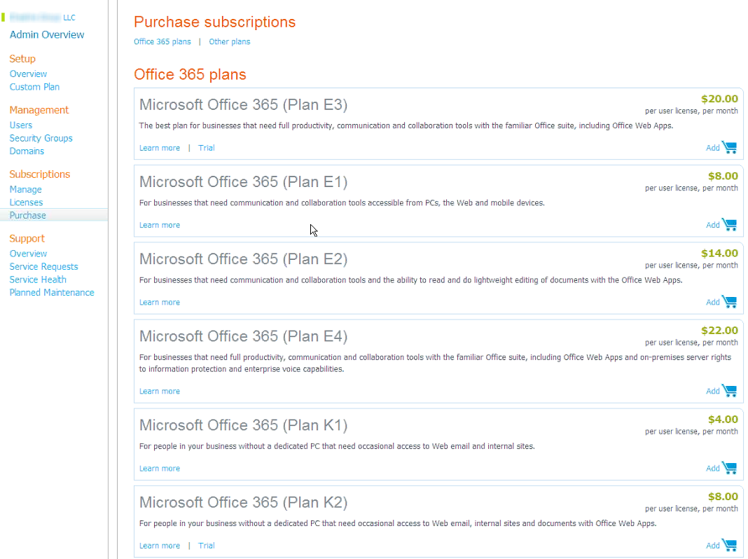

Slide 26
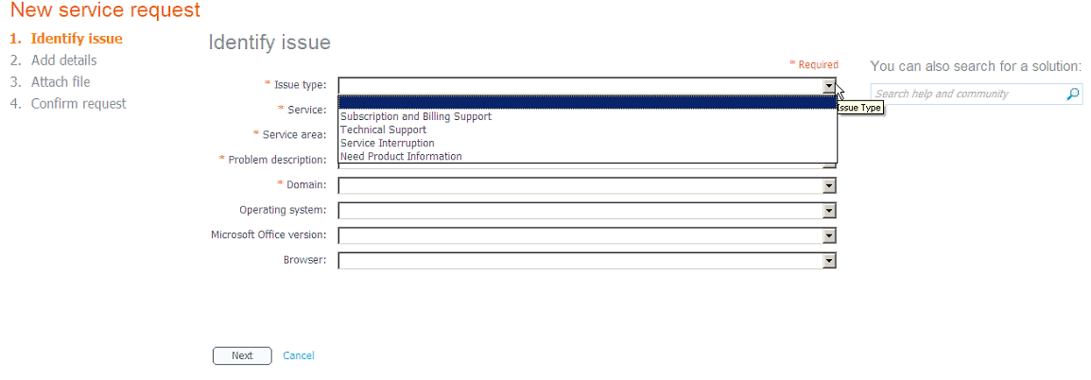

Slide 27
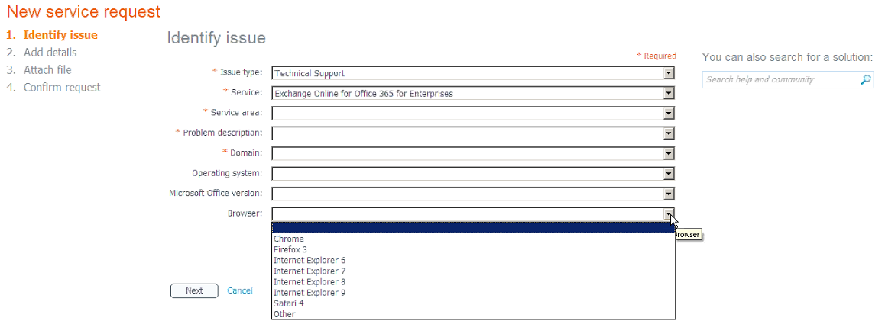

Slide 28
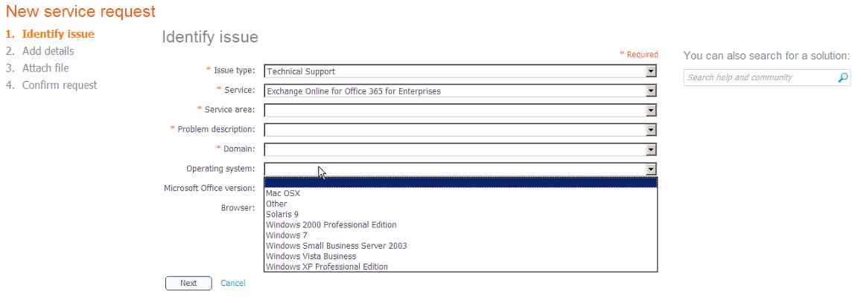

Slide 29


Slide 30


Slide 31


Slide 32


Slide 33
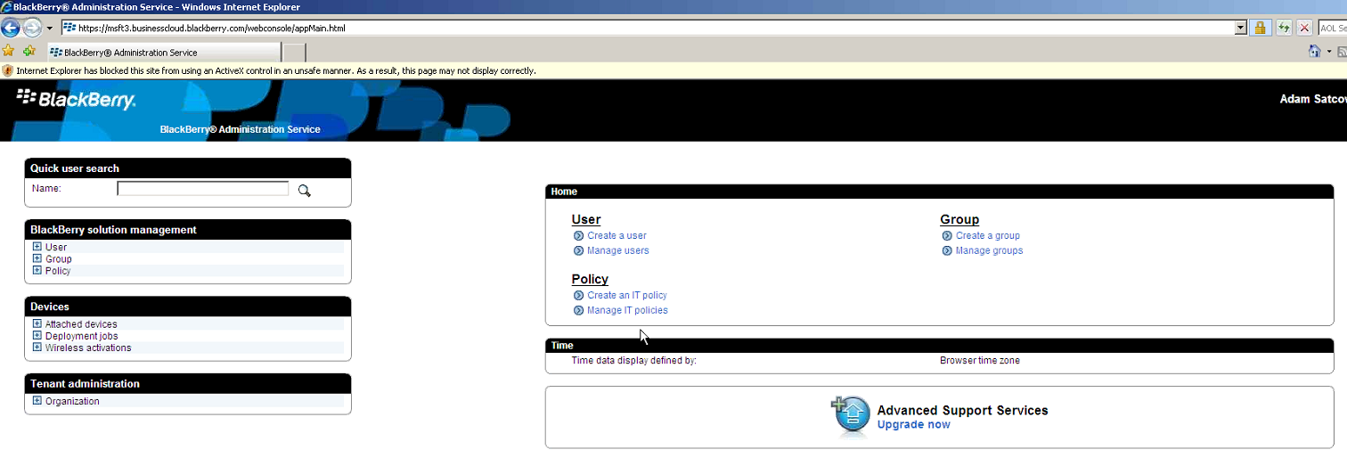

Slide 34


Slide 35
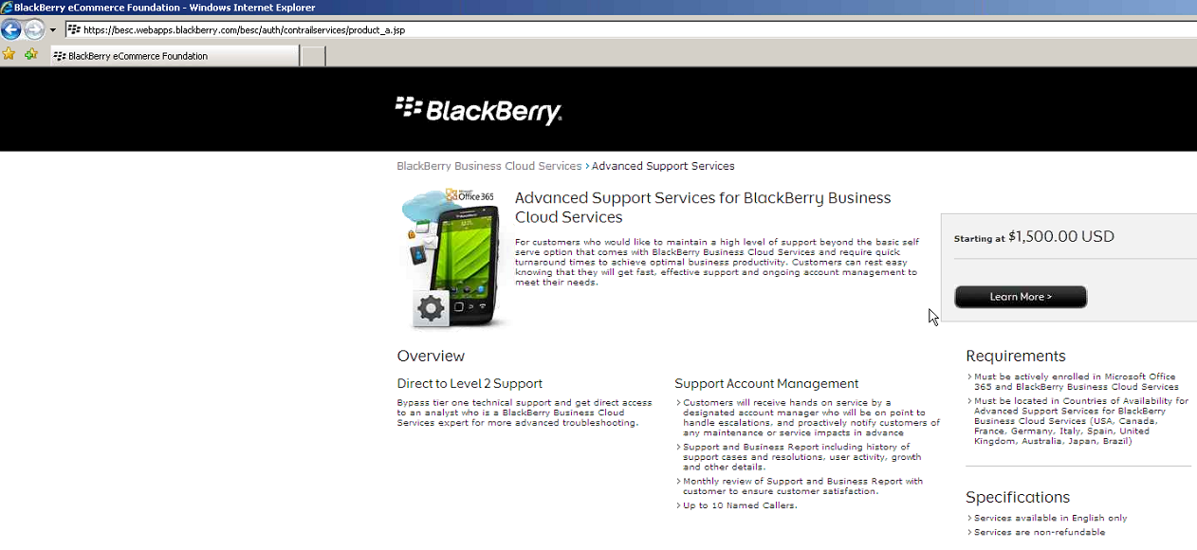

Slide 36
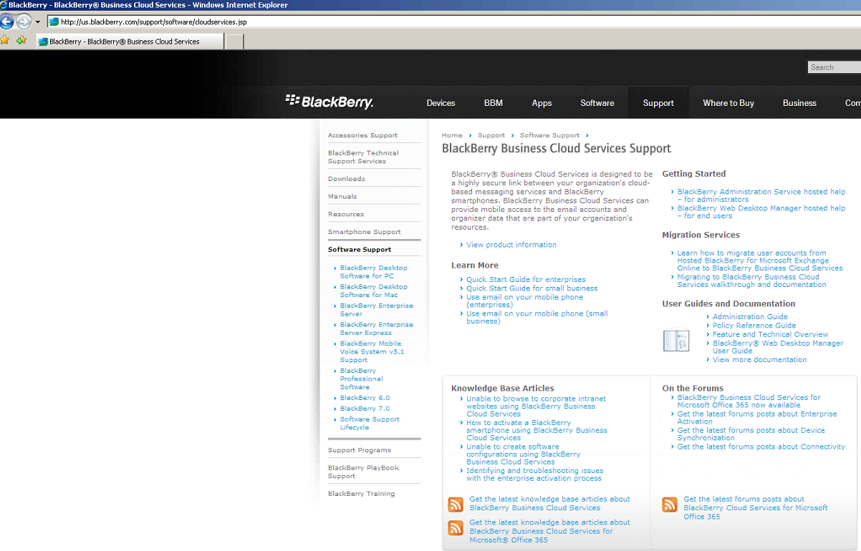

Slide 37
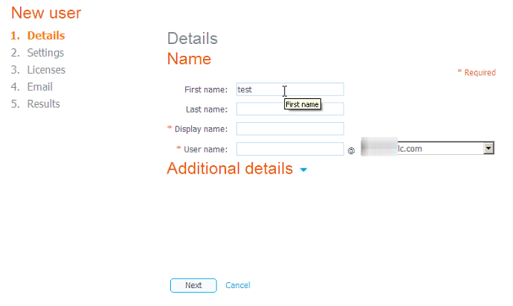

Slide 38
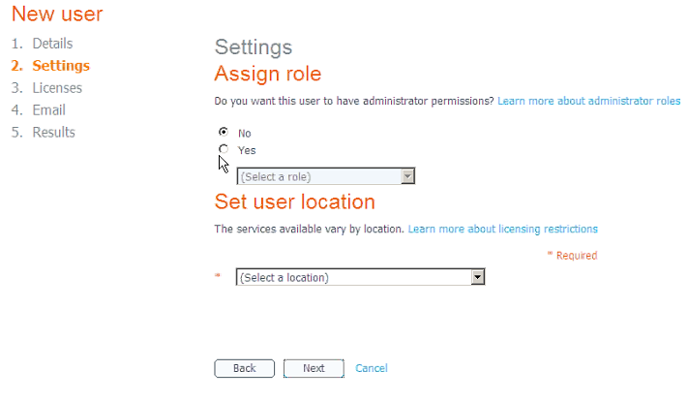

Slide 39
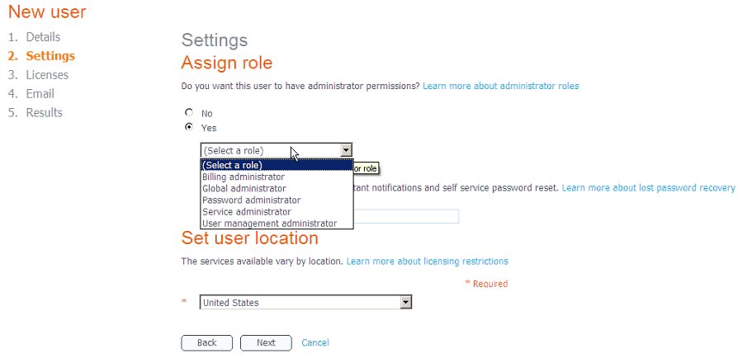

Slide 40


Slide 41
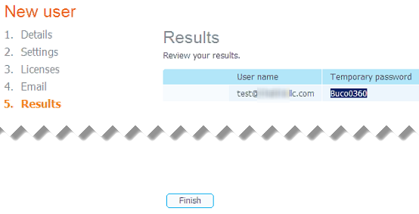

Slide 42
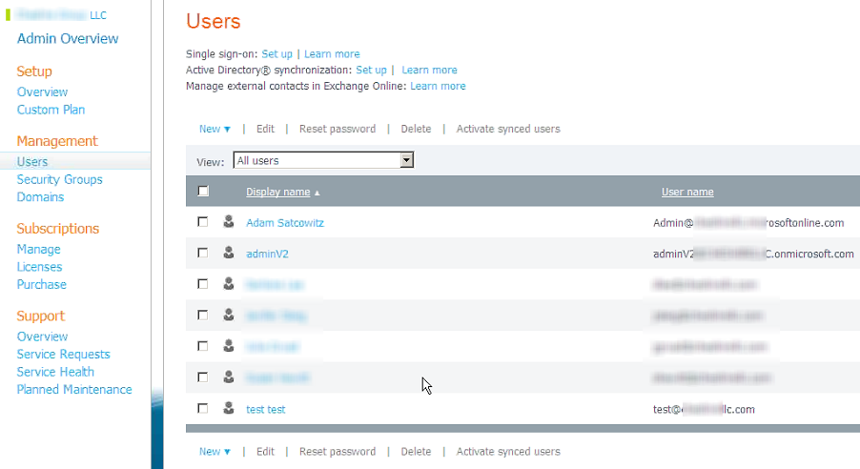

Slide 43
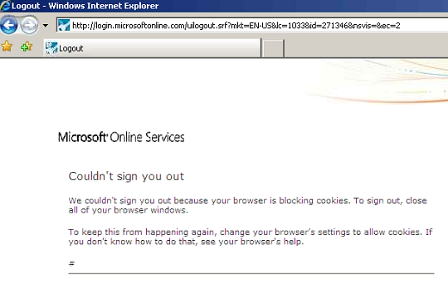

Slide 44
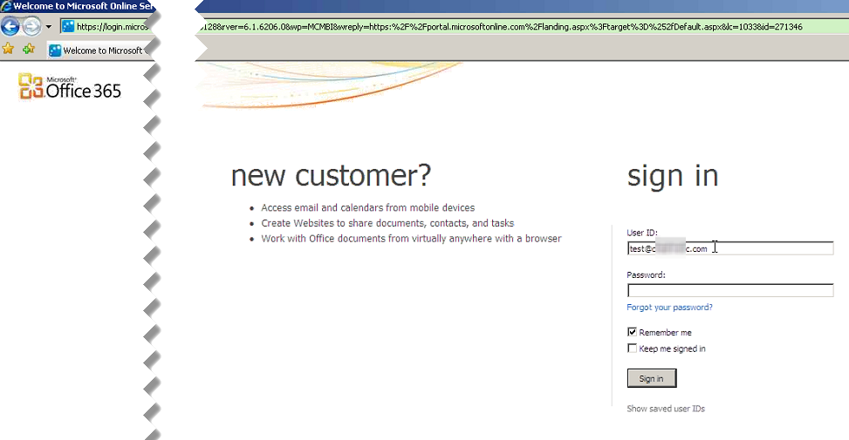

Slide 45
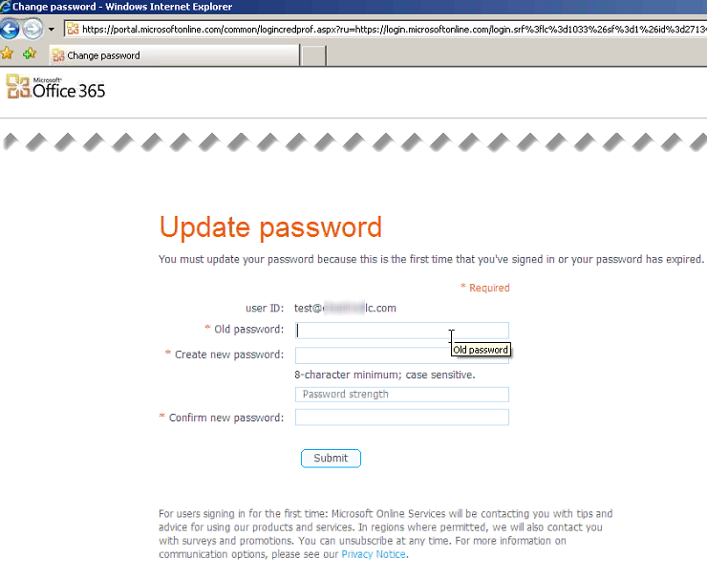

Slide 46
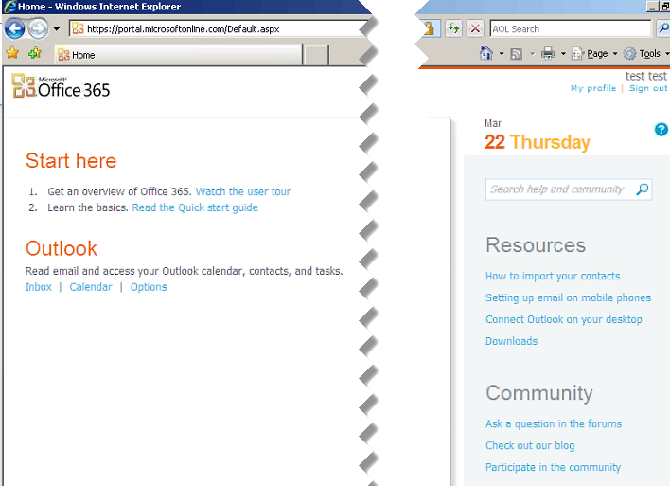

Slide 47
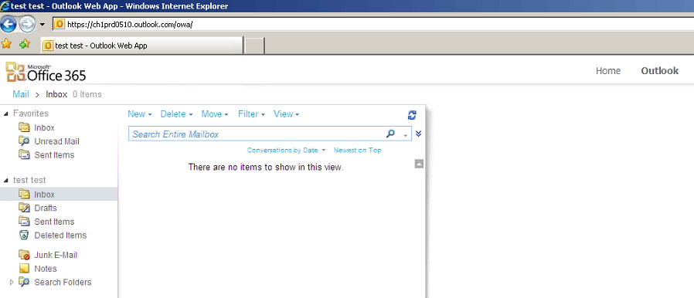

Slide 48
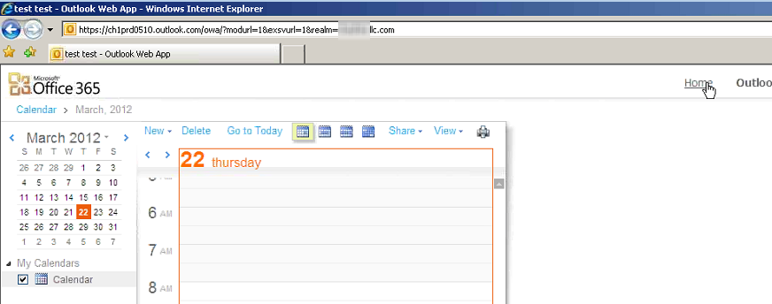

Slide 49
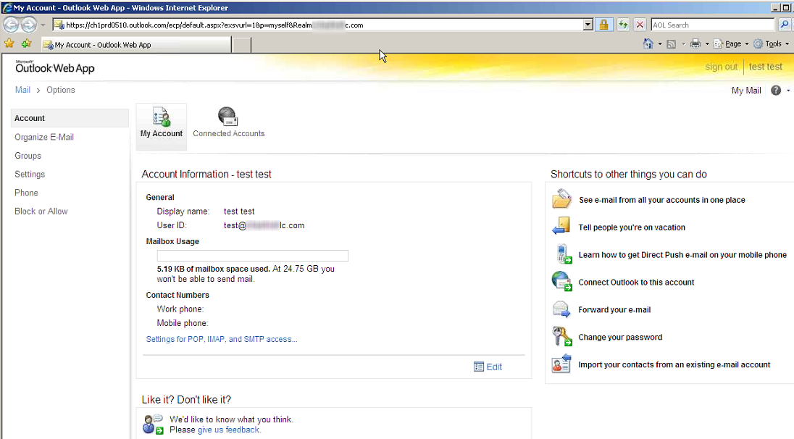

Slide 50
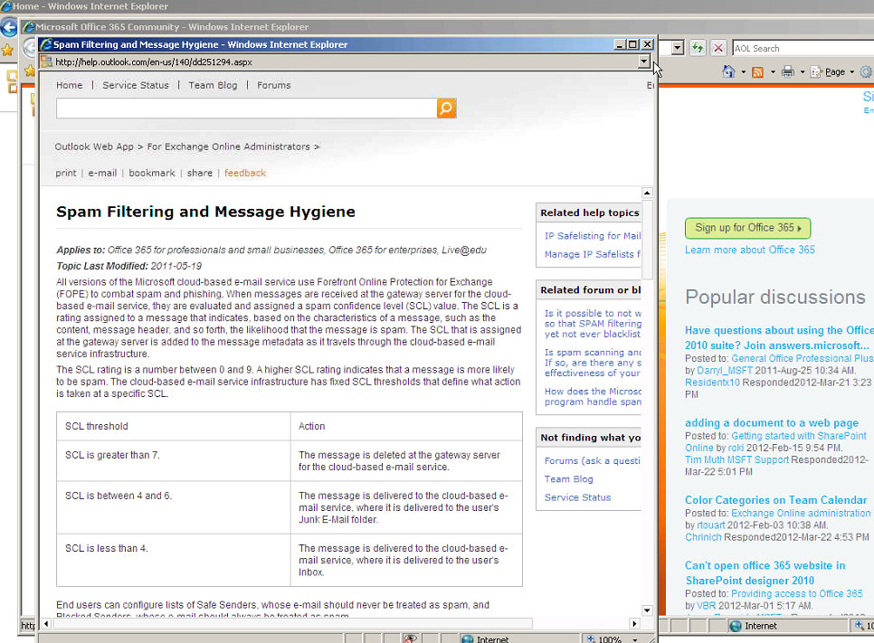

Slide 51
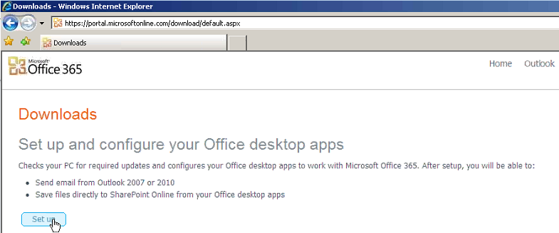

Slide 52
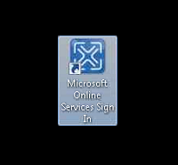
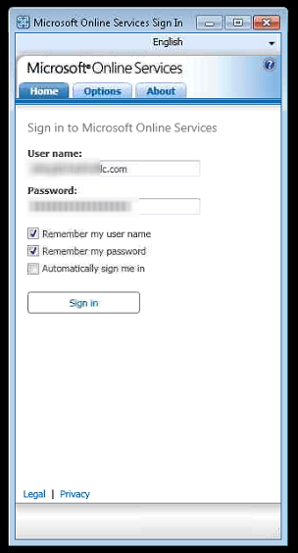
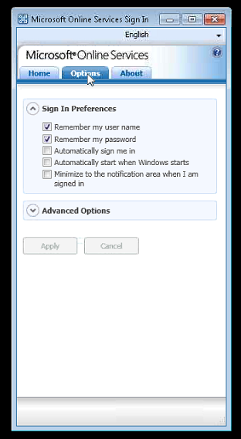
Microsoft Online Services application will setup Outlook profile and configure authentication. Microsoft wants you to use this application. The settings are nearly impossible to find.

Slide 53
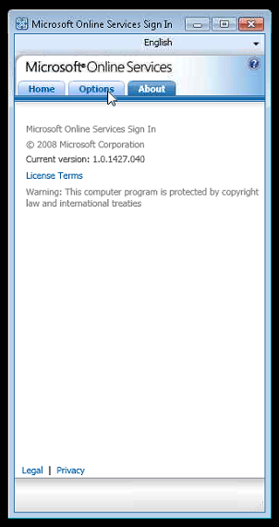

Slide 54
Thank you Adam for presenting on Office 365 and to all our attendees for coming to tonight’s NY Exchange User Group Meeting.
TechHit.com (Outlook add-ons) – raffling off any one of their products (SimplyFile [intelligent filing], EZ-Detach [easily detach multi-emails of attachments], MessageSave [backup, archive, save msgs], AutoRead [mark as read/remove new mail icon], & QuickJump [quickly open/move between Windows folders].
Now for Question of the Month……

