Slide 1
Exchange Server 2010
Personal Archive &
Retention Policies
Ned Gnichtel
Technical Specialist - UC
Microsoft Corporation
edwingn@microsoft.com

Slide 2

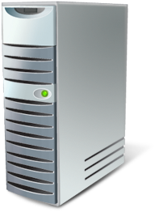






Exchange Enterprise Topology
Enterprise Network
Phone system (PBX or VOIP)
Edge Transport
Routing and AV/AS
Hub Transport
Routing and policy
External
SMTP
servers
Mailbox
Storage of mailbox items
Unified Messaging
Voicemail and
voice access
Mobile phone
Client Access
Client connectivity
Web services
Web browser
Outlook (remote user)
Line of business application
Outlook (local user)
Notes:
Situation:
In the past, new versions of Exchange Server sometimes meant a new architecture.
Talking Points:
No new architecture for Exchange 2010 from Exchange Server 2007 (Note: there are differences for High availability, and MAPI on the Middle-Tier but the overall 5 server design is the same).
Slide Objective:
No architectural change in terms of roles and firewall exposure from Exchange 2007.

Slide 3


Continuous Availability
Simplify mailbox resiliency with new unified solution for High Availability, Backup, and Disaster Recovery
San Jose
New York
Mailbox Server
Mailbox Server
Mailbox Server
DB1
DB1
DB1
Replicate databases to remote datacenter
Recover quickly from disk and database failures
DB2
DB2
DB2
DB3
DB3
DB3
DB4
DB4
DB4
DB5
DB5
DB5
Evolution of Continuous Replication technology
Provides full redundancy of Exchange roles on as few as two servers
Reduce backup frequency through up to 16 replicas of each database
Can be deployed on a range of storage options
Notes:
Situation:
As the importance of email communications in today’s workplace continues to grow, companies count on their IT staff to prevent email outages and data loss.
Traditionally, customers have been required to deploy expensive shared-storage clustering and purchase 3rd party data replication products to provide full redundancy of Exchange Server services and data.
Exchange Server 2007 introduced a built-in data replication technology called Continuous Replication, which significantly reduced the cost of deploying a highly available Exchange infrastructure.
Running a highly available Exchange infrastructure still requires a great deal of time and expertise, because integration between Exchange Server and Windows Clustering is not seamless.
Companies want an easier way to replicate their email data to a remote location, in order protect their Exchange environment against site-level disasters.
Slide Objective:
Position the new HA model as the evolution of previous HA methods, with significantly less cost and complexity.
Talking Points:
Exchange Server 2010 uses the same Continuous Replication technology found in Exchange 2007, combining on-site data replication (CCR) and off-site data replication (SCR) into a single framework called a “Database Availability Group.”
Exchange Server Database Availability Groups handle all aspects of clustering internally. There is no need to manage failover clustering separately in Windows Server.
Administrators can add replicated database copies incrementally (up to 16 total), and Exchange switches between these copies automatically as needed to maintain availability.
Mailbox servers involved in clustering can host other Exchange roles (Client Access, Hub Transport, etc), so full redundancy of Exchange services and data can be achieved with just two servers.
Legacy Exchange clustering (Single copy clustering, which was the only clustering option in Exchange 2000 and Exchange 2003) is being retired in favor of Exchange 2007-style clustering. 3rd party replication products will still be supported.
The new high availability architecture provides simplified recovery from a variety of failures (disk-level, server-level, and datacenter-level), and can be deployed on a variety of storage types (as described in the previous slide).

Slide 4
Improved Storage Utilization
4x increase in number of mailboxes per disk
Mailboxes/Disk
  Reduced IO enables more mailboxes per disk
  Utilize more disk capacity before performance limits are reached
+500
125
Notes:
Situation
Exchange I/O requirements often result in disks running out of performance before they run out of capacity.
Slide objective
I/O improvements in Exchange 2010 results in the ability to put more mailbox per disk.
Talking points
IOPS improvements result in the ability to put a larger number of mailboxes per disk – the disks will exceed capacity before the performance limits are reached which results in better utilization of the storage.
Data: 250MB Mailbox Size, 3MB DB Cache/user, 12 x 7.2k SATA disks (DB/Logs on same spindles), Loadgen Outlook 2007 Online Very Heavy Profile, measured at <20ms RPC Average latency

Slide 5
Exchange IOPS Trend
+90% Reduction!

Slide 6

Email Archiving
Preserve and discover email data without changing the user or IT pro experience
Preserve
Discover
Personal Archive
Move and Delete Policies
Hold Policy
Multi-Mailbox Search
Secondary mailbox with separate quota
Appears in Outlook and OWA
Managed through EMC or PowerShell
Automated and time-based criteria
Set policies at item or folder level
Expiry date shown in email message
Capture deleted and edited email messages
Offers single item restore
Notify user on hold
Web-based UI
Search primary, archive, and recoverable items
Delegate through roles-based admin
Notes:
Situation
Because of growing and changing regulatory environments, organizations need custom, easy-to-implement email archiving capabilities that do not interfere excessively with user workflows.
Slide objective
Audience should understand how they can get robust email archiving and discovery tools without burdening the IT department or users.
Talking points
Exchange Server 2010 offers you new, integrated email archiving tools that can help you preserve and discover email data, without having to change the way your users or IT admins work with and manage Exchange.
Introduced in this latest release are such features as:
A personal archive that seamlessly surfaces in both Outlook and Outlook Web App. This secondary mailbox appears a set of folders in your users’ email clients, allowing them to use familiar tools and actions to manage both live and archived email data. For administrators, the very same admin tools used to manage other aspects of Exchange, such as the Exchange Management Console or PowerShell, can be used to configure and enable this personal archive.
Retention policies that allow IT staff to define, deploy, and automate the expiry and archiving of email data. These new policies are both granular and flexible, and can be set at either the folder or item level. New to Exchange 2010 is a legal hold policy that, when enabled on a user’s mailbox, retains any edits or deletions made by the user under hold. This new feature also adds a single item restore capability to help undo accidental user deletions, without having to restore from a point in time backup.
The new, easy to use, web-based multi-mailbox search that can be delegated to specialist users—such as a compliance officer or human resources personnel—to conduct e-discovery tasks, without having to generate additional overhead for the IT department.
Together, these integrated email archiving, retention, and discovery capabilities form just one aspect of our large mailbox strategy which includes all of the great Exchange Server 2010 mailbox resiliency and storage performance innovations, as well as choice in storage hardware we’ve already discussed.

Slide 7
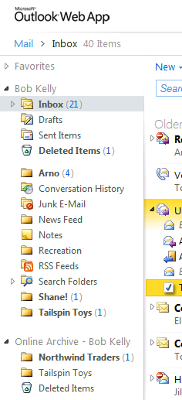
A Familiar Personal Archive
A specialized Exchange mailbox configured and associated with the user’s primary mailbox
Delivers your users a familiar experience by seamlessly surfacing in both Outlook and Outlook Web App
Your users can use the same skills and methods they already use today to interact with archive email:
    “Drag and Drop” email to folders
    Create folders and categorize
    Conduct searches and filter results
    Reply to messages and set flags
  Separate quotas may be set for archive and primary mailboxes
Primary Mailbox
Archive
Notes:
Situation
The Personal Archive features of Exchange 2010 delivers a familiar user experience in both Outlook 2010 and Outlook Web App.
Slide objective
Describe the features and functionality of Personal Archiving in Exchange 2010.
Talking Points
First…there is the personal archive. This is a secondary mailbox…that is enabled…and associated with a user’s primary Exchange account.
To help deliver…a familiar experience for your users…the personal archive…appears like any other folder…or opened PST file…in both Outlook…and Outlook Web App.
This means…your users can easily interact…with their archived email…utilizing the same methods they already use today…like dragging and dropping email from the Inbox to other folders. Searching for messages across either live or archived email…is the same experience…including having rich options for filtering the search results…such as only showing messages that include attachments or that have been tagged with a specific category.
Administrators…using existing Exchange management tools…can set a separate quota for the archived mailbox…independent from the primary mailbox. And…utilizing the enhanced retention policies framework introduced in Exchange 2010…you can define policies that automatically move email into a user’s personal archive…based on specific time-based criteria.
These two mailboxes (the primary and the archive can live in the same Exchange database or in an separate store) allows you to benefit from a range of Exchange 2010 mailbox resiliency and storage innovations…like the option to use low-cost storage hardware…to deliver both a large sized mailbox and a robust email archiving approach…in fashion that can drive greater efficiency in and performance of your infrastructure investments…all while still helping to lower IT costs.

Slide 8
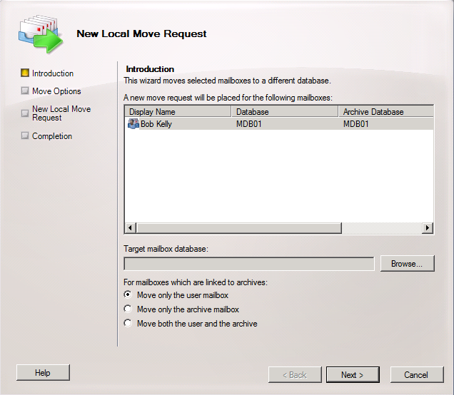
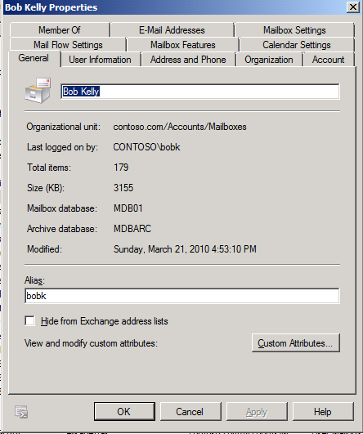

Email Archiving
Users primary and archive mailboxes can be located on the same or separate databases*
Mailboxes can be moved together or separately
Allows for different storage hardware, DAGs, RPOs, RTOs, etc.
Exchange 2010 SP1 supports:
  Primary and Archive On-Premises (Same DB)
  Primary and Archive On-Premises (Different DBs)
  Primary and Archive in the Cloud
  Primary On-Premises and Archive in the Cloud
*Requires Exchange Server 2010 Service Pack 1

Slide 9
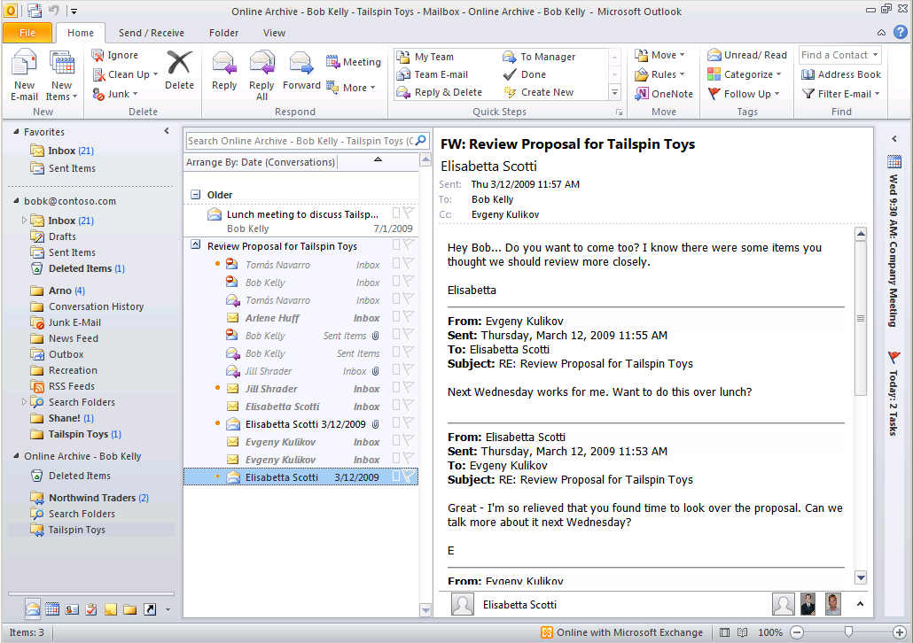
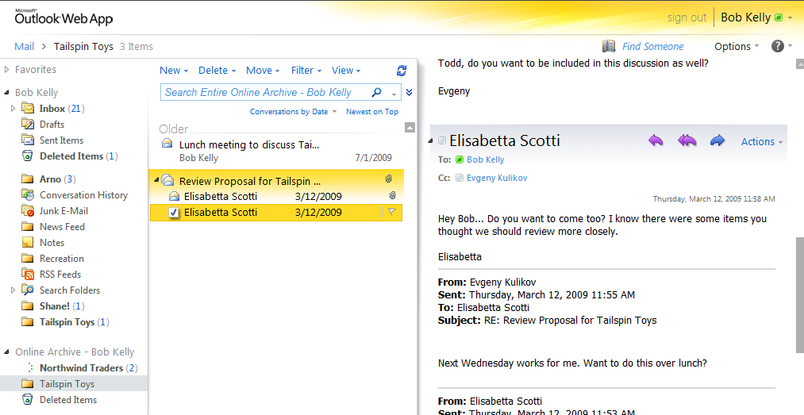
A Seamless User Experience
Read, reply, and navigate archived email same as live email
Conversation view scoped to archived email
Primary mailbox folder hierarchy maintained
Notes:
Situation
The Personal Archive features of Exchange 2010 delivers a familiar user experience in both Outlook 2010 and Outlook Web App.
Slide objective
Describe the features and functionality of Personal Archiving in Exchange 2010.
Talking Points
Your users can utilize the same skills, steps, and methods to conduct common tasks, across both live and archived email data. And, since the archived email data is stored in Exchange, your users experience the full fidelity of new productivity boosting user features, like the conversation view, across their archive. Lastly, if email data is automatically moved to the Personal Active by a “Move to Archive” policy, the folder hierarchy is preserved. This is similar to the “AutoArchive” experience when email is automatically moved into a .PST file by Outlook.

Slide 10
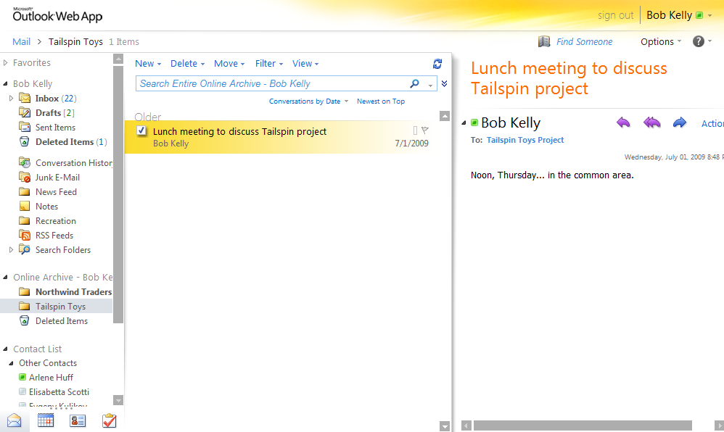
Online Archive
Archive in the folder list
Treat like any other folder
Access your PST from the Web

Slide 11
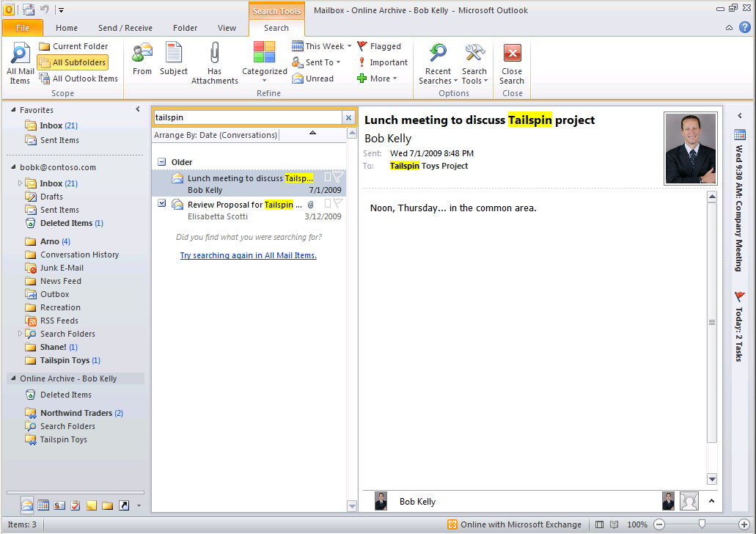
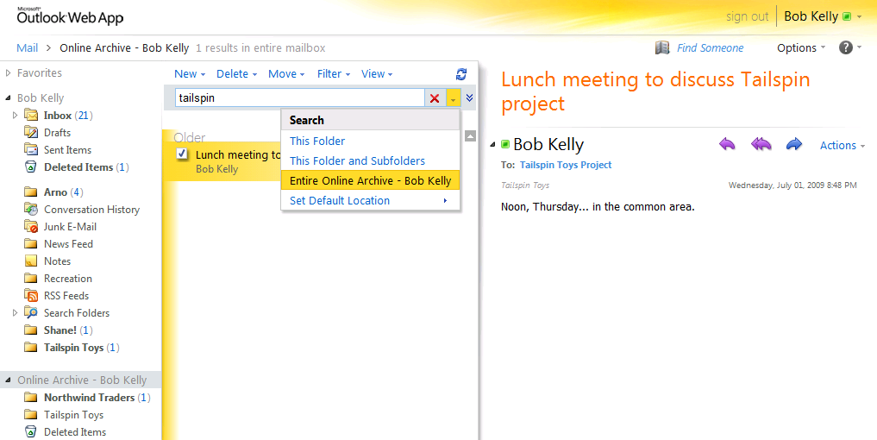
One User Search Experience
Same search steps with option to search across archived email
Notes:
Situation
The Personal Archive features of Exchange 2010 delivers a familiar user experience in both Outlook 2010 and Outlook Web App.
Slide objective
Describe the features and functionality
Talking Points
A common challenge with other email archiving approaches, is having to give your users one experience when working with live email, and yet another when needing to do the same action in their archive. Search is an example of this situation. Because the Personal Archive is, effectively, just another mailbox, all of the steps are familiar to your users, whether live or archived email.

Slide 12
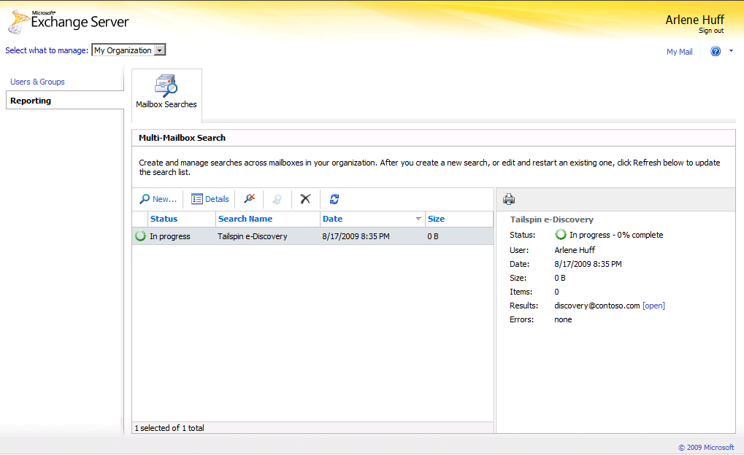
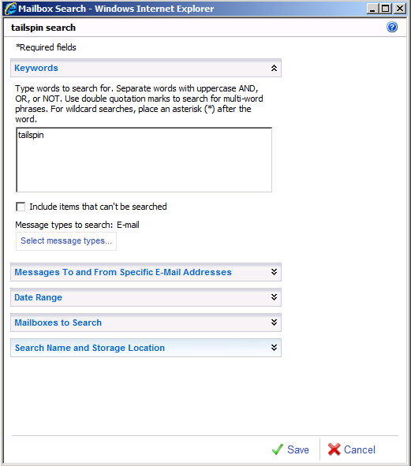
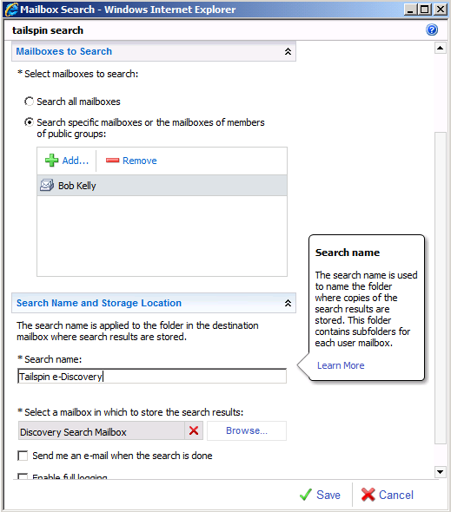
Email Archiving
Empower compliance officers to conduct
multi-mailbox searches with ease
Delegate Access to Specialists
Rich Search Criteria and Targeting Options
Results Stored in Specialized Mailbox
Notes:
Situation:
Traditional email systems require complex access control policies and provide hard to use tools in order to meet the growing needs of eDiscovery and requirements of Human Resources departments relative to searching corporate communication throughout the email infrastructure. Those responsible for these tasks are non-IT users who are unfamiliar with email administration tools and do not have access to the email servers. These compliance officers and HR representatives are having to follow complex processes and use complex tools, aided by IT, to handle what is already a complex problem due to legal and corporate governance. Solutions are required which empower these individuals to go about their business without IT intervention and which ensure that only those assigned by the organization to perform such tasks are able to.
Slide Objective:
The audience should see that Exchange goes beyond traditional administration models to empower delegation of tasks associated with compliance away from the email administrator and put these tasks into the hands of those responsible with easy-to-use tools.
Talking Points:
Cross-mailbox search user interface enables compliance officers and HR to perform searches based on select email attributes across the entire mail infrastructure.
Roles based administration allows for easy delegated access to this tool with no complex Access Control Requirements.
eDiscovery processes may be followed without IT intervention and only by those authorized.
Compliance officers and HR representatives use familiar and easy-to-use tools within the existing UI of Outlook Web App (compared to Get Mailbox PowerShell commands in E2007).

Slide 13
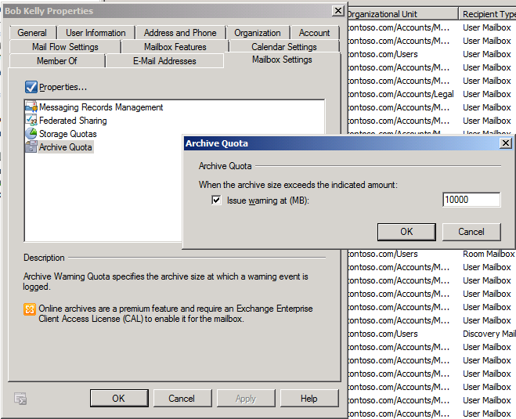
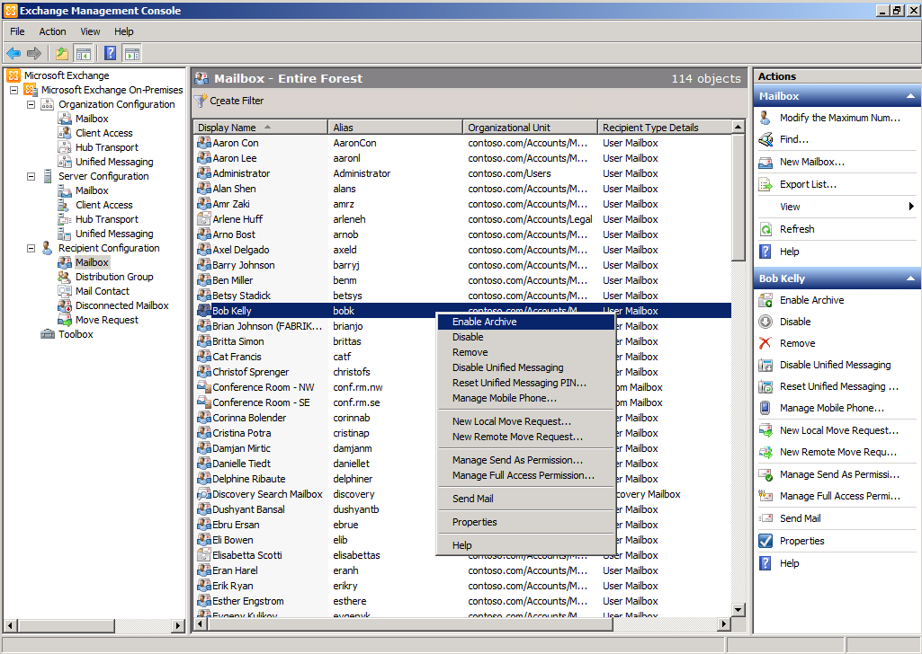
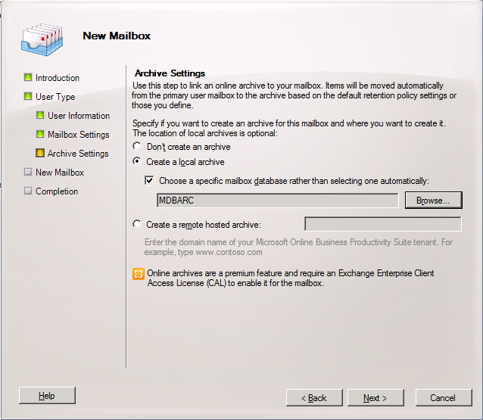
Streamlined Administration
Use your existing Exchange admin skills and tools to manage and deploy the personal archive
Set separate quota for archive mailbox
Enable the archive on an existing mailbox
Add an archive when creating a new mailbox
Notes:
Situation
Administrative tasks are greatly simplified, including using the same skill set and admin tools (like the Exchange Management Console and PowerShell).
Slide objective
Demonstrate how the email archiving administration is streamlined thanks to familiar tools.
Talking Points
The very same administrative tools you use today, like the Exchange Management Console and PowerShell, can be used to enable and configure the Personal Archive (as well as other integrated archiving, retention, and discovery capabilities). For example, you can easily add an archive to your users existing mailbox or when you create a new mailbox. You can also set separate quotas for the primary and archive mailbox, and even customize the name for the archive folder that appears in Outlook 2010 and Outlook Web App.

Slide 14
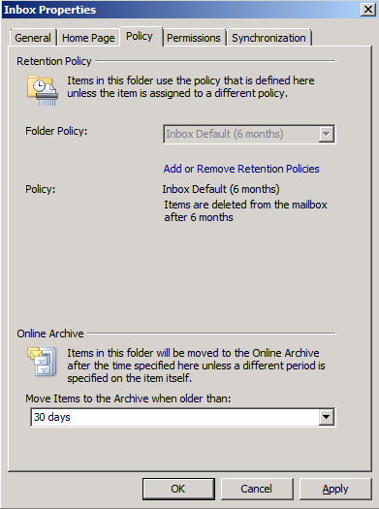
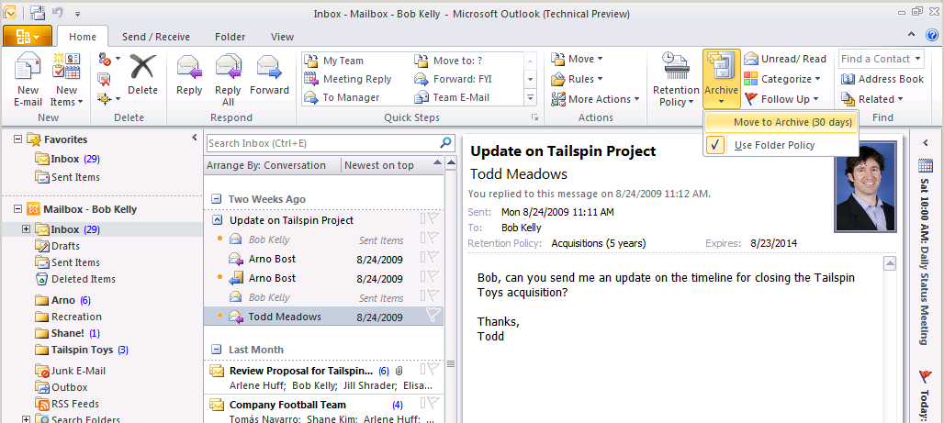
Retention Policies
Set granular per item retention policies and capture all edits and deletions with legal hold
Apply Move and Delete Policies to Individual Messages
Policies Applied to All Email Within a Folder
Retention Policy and Expiry Details
Notes:
Situation:
The explosive growth of regulatory compliance and corporate governance requirements has made it challenging for email administrators and compliance officers to provide end users with simple tools for managing retention policies of the high volume of email messages being sent and received daily. It is impractical for a small group of people to police email to this end directly, so tools which enable end users to apply retention policies which are defined by the organization and tools which automatically apply such policies without IT intervention are required to effectively mitigate the risk associated with compliance and governance.
Slide Objective:
The audience should walk away understanding that Exchange increases flexibility and functionality allowing retention policies to be applied to emails individually or at the folder level. IT administrators and compliance officers can define policies and distribute them to select groups of users ensuring that users choose from only policies which are appropriate for their role in the company.
Talking Points:
Retention policies can now be applied to any individual email or folder rather than just a restricted set of managed folders.
Policies are defined centrally and pushed to the client, exposed directly to users in the UI for selection or notification.
Transport rules can be designed to automatically apply default policies for select groups of users or based on select attributes of email.

Slide 15
Retention Policies In-Depth
MRM in Exchange 2010 is accomplished by using retention tags and retention policies.
  Assigning retention policy tags (RPTs) to default folders, such as the Inbox.
  Applying a default policy tag (DPT) to mailboxes to manage the retention of all untagged items.
  Allowing the user to assign personal tags to custom folders and individual items.
Tags are assigned to Retention Policies which are assigned to User Mailboxes

Slide 16
Retention Policies In-Depth
Use retention policies to group one or more retention tags and apply them to mailboxes.
Retention Policy can contain the following tags:
  One DPT for Archive action
  One DPT for Delete action
  One or more RPTs for supported default folders.
  Any number of personal tags.

Slide 17
Retention Policies In-Depth
  Key Differentiator versus Managed Folders:
    MRM functionality is separate from users' Inbox management and filing habits.
    Users aren't required to file messages in managed folders based on retention requirements.
    Individual messages can have a different retention tag than the one applied to the folder in which they're located.

Slide 18
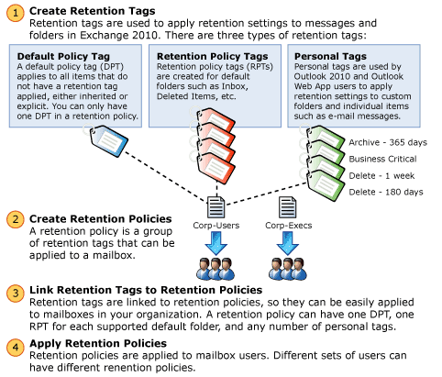
Retention Policies In-Depth

Slide 19
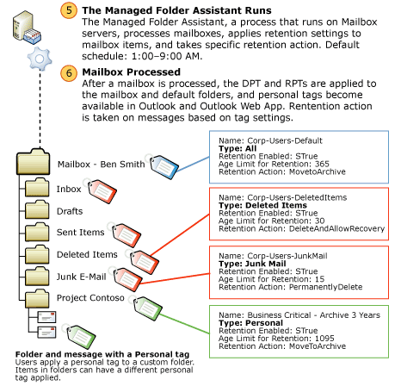
Retention Polices In-Depth

Slide 20
Types of Retention Tags
Default policy tags (DPTs) DPTs apply retention settings to untagged mailbox items.
Retention policy tags (RPTs) RPTs apply retention settings to default folders such as Inbox, Deleted Items, and Sent Items.
Personal tags Personal tags are available to Outlook 2010 and Outlook Web App users as part of their retention policy.

Slide 21
RPT Usage
You can create RPTs for the following default folders:
  Deleted Items, Drafts, Inbox, Junk E-mail, Outbox, Sent Items, RSS Feeds, Sync Issues, Conversation History
IMPORTANT:
  You can't include more than one RPT for the same default folder type in one retention policy.
  RPTs aren't supported for the Calendar, Contacts, Journal, Notes, and Tasks default folders.

Slide 22
Retention Actions
MoveToArchive The MoveToArchive action moves a message to the user's archive mailbox.
MoveToDeletedItems The MoveToDeletedItems action moves messages to the Deleted Items folder.
DeleteAndAllowRecovery The DeleteAndAllowRecovery action moves the item to the dumpster
PermanentlyDelete The PermanentlyDelete action permanently deletes a message.
MarkAsPastRetentionLimit The MarkAsPastRetentionLimit action marks a message as past the retention limit.

Slide 23
Example Retention Schema
Policy 1 has these tags:
  Move DPT, moves to archive in 3 years.
  Expiry DPT, deletes items in 7 years.
  RPT for Deleted Items folder, deletes in 60 days.
  Personal Tag1: Move to archive in 30 days.
  Personal Tag2: Delete in 60 days.

Slide 24
Example Retention Schema
Result:
  All items in mailbox moved to archive in 3 years.
  All items in mailbox + archive deleted after 7 years.
  Items in Deleted items deleted in 60 days (don’t get moved to archive).
  User applies PT1 to item1, moves to archive in 30 days, deleted in 7 years.
  User applies PT2 to item2, deleted in 60 days, doesn’t move to archive.

Slide 25
Creating Policies
Step 1: Create tags – example, DPT
  New-RetentionPolicyTag "Delete-15-Default" -Type All -IsPrimary $true -Comment "Items without a retention tag are Deleted after 15 years" -RetentionEnabled $true -AgeLimitForRetention 5475 -RetentionAction PermanentlyDelete
  Note: Every Policy must have a Primary DPT. For other DPT’s, create the tag without the “IsPrimary” arrtibute

Slide 26
Creating Policies
Step 2: Create Policy and Assign Tags:
  New-RetentionPolicy "Basic Users" -RetentionPolicyTagLinks "Move-Default","Delete-15-Default“
Step 3: Assign Policy:
  Set-Mailbox “Ned" -RetentionPolicy “Basic Users“
This Policy will now move mail to the Archive in 1 year and Permanently Delete in 15

Slide 27
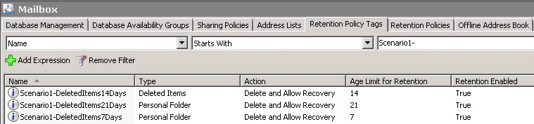
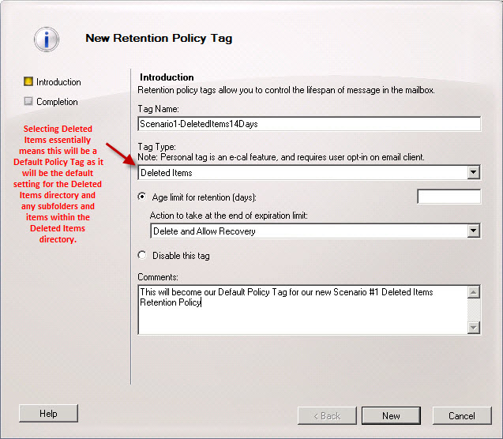
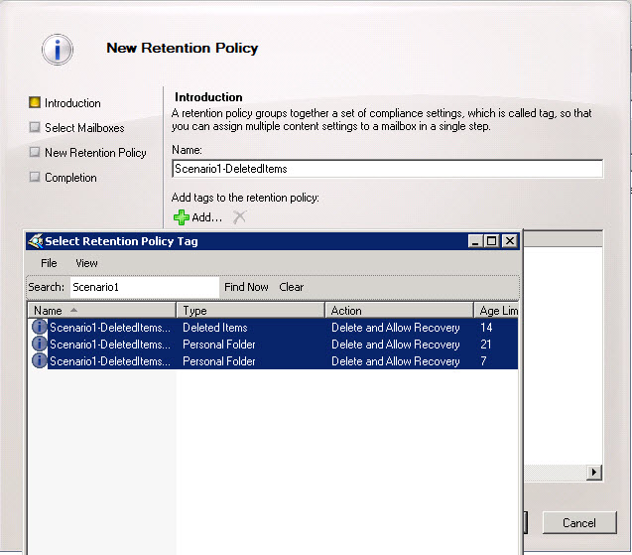
SP1 Enhancements
Today: All management of Retention Policies is performed through the Exchange Management Shell (PowerShell)
SP1 will introduce EMC Retention Tag, Policy and Assignment management
Self Service Assignment of Optional Retention Policy via the ECP

Slide 28

© 2009 Microsoft Corporation. All rights reserved. Microsoft, Exchange ActiveSync, Forefront, Outlook, Windows Mobile, and other product names are or may be registered trademarks and/or trademarks in the U.S. and/or other countries. The information herein is for informational purposes only and represents the current view of Microsoft Corporation as of the date of this presentation. Because Microsoft must respond to changing market conditions, it should not be interpreted to be a commitment on the part of Microsoft, and Microsoft cannot guarantee the accuracy of any information provided after the date of this presentation. MICROSOFT MAKES NO WARRANTIES, EXPRESS, IMPLIED OR STATUTORY, AS TO THE INFORMATION IN THIS PRESENTATION.

